Slide 1
Chapter 16
The Rational（理性的）Treatment of Cancer
Dec 29, 2023

Slide 2
Outline of this lecture
1, Cancer detection and stratification;
2, Traditional cancer treatment;
Chemotherapy history and example.
3, Rational cancer treatment;
Druggable target;
Imatinib/Gleevec and chronic myelogenous leukemia (CML, 慢性髓细胞性白血病);
ATRA+As₂O₃ and acute promyelocytic leukemia (APL,急性早幼粒细胞白血病);
Cyclopamine in medulloblastoma (髓母细胞瘤);
Proteasome inhibitor (Velcade) and multiple myeloma (多发性骨髓瘤);
EGFR inhibitor in various cancer;
Vemurafenib and B-raf V600E in melanoma;
Cancer precision therapy (Immunotherapy and targeted therapy).

Slide 3
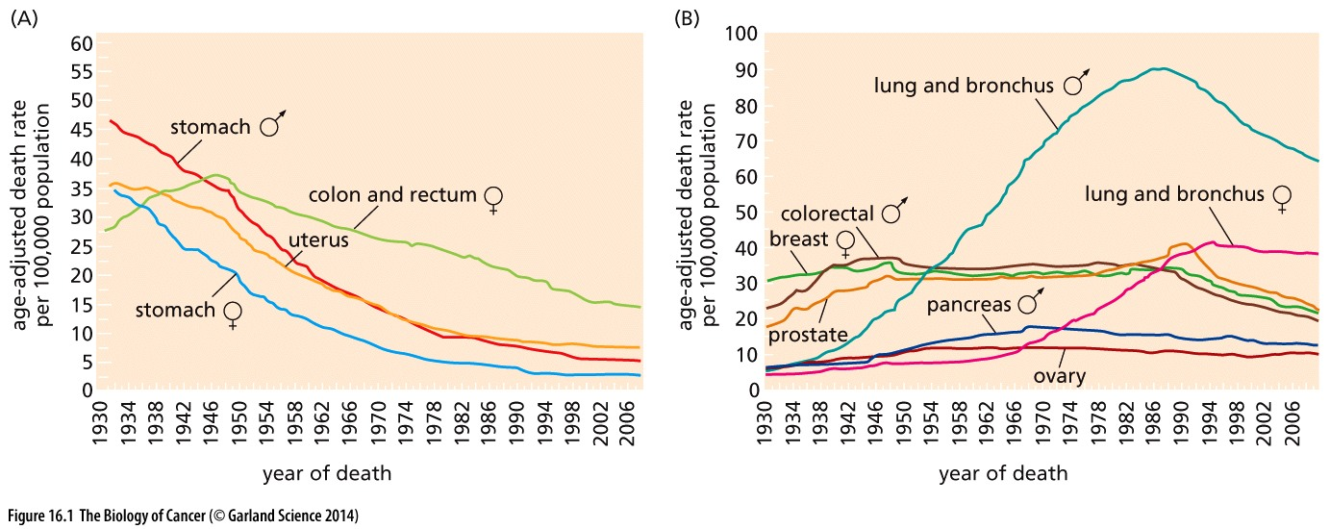
Figure 16.1 Cancer mortality over the past three-quarters of a century: the lay of the land
(A) Mortality from several major killers has declined significantly since 1930. This is due to changes in food storage practices and possibly Helicobacter pylori(幽门螺旋杆菌) infection rates, in the case of stomach cancer, and to screening, in the cases of uterus（子宫）and colorectal cancers.
(B) A number of major sources of cancer-related death have proven resistant to most forms of traditional therapy. Including prostate, breast, lung, colorectal, pancreas and ovary cancer

Slide 4
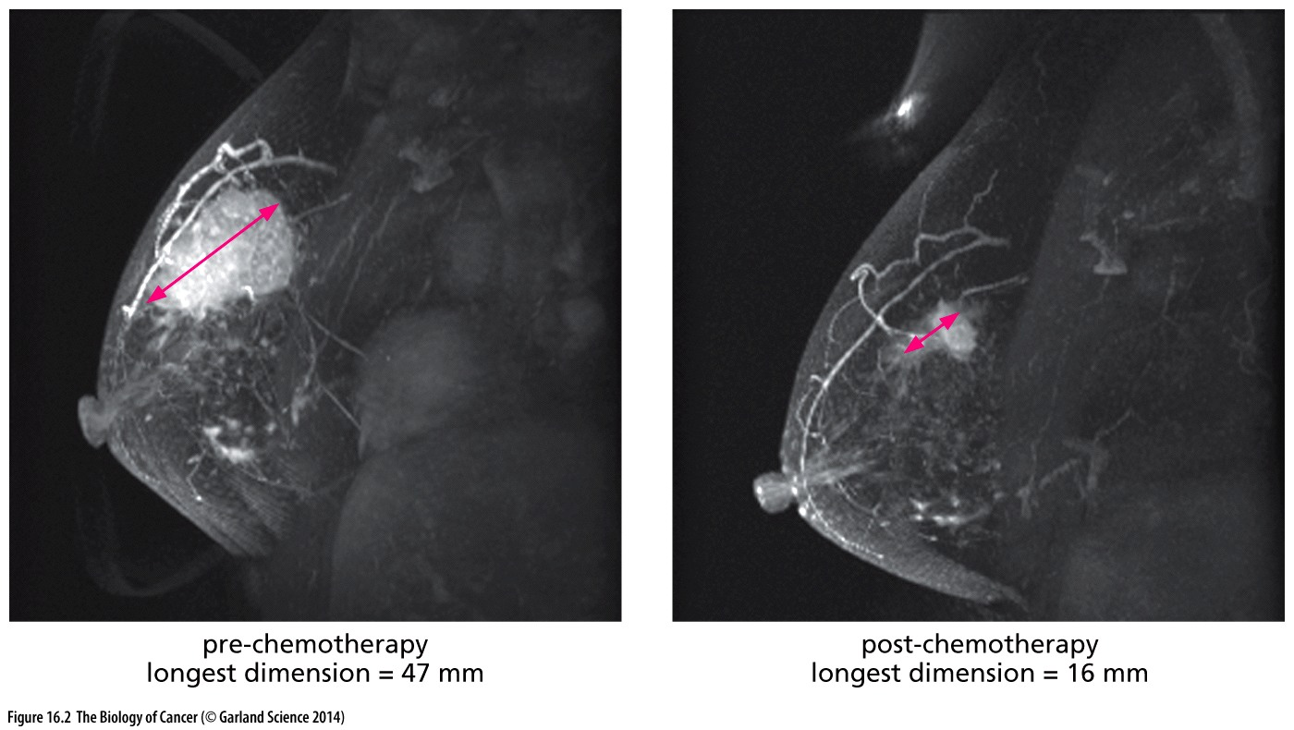
Figure 16.2 High-resolution noninvasive imaging of human tissues
The development of magnetic resonance imaging (MRI) has enabled increasingly higher-resolution, noninvasive visualization of living tissues. MRI now allows breast tumors of very small size (several mm diameter) to be detected and, as shown here, makes it possible to view the progress of anti-tumor therapy in exquisite detail. Widespread use of such highly sensitive imaging techniques is likely to result in further increases in the incidence rate of breast cancer with unknown effect on the mortality of the disease.
Notes:
除了MRI，其他肿瘤成像方法还有：
CT (computerized tomography) scan,
General/body ultrasound,
PET (positron emission tomography) scan

Slide 5
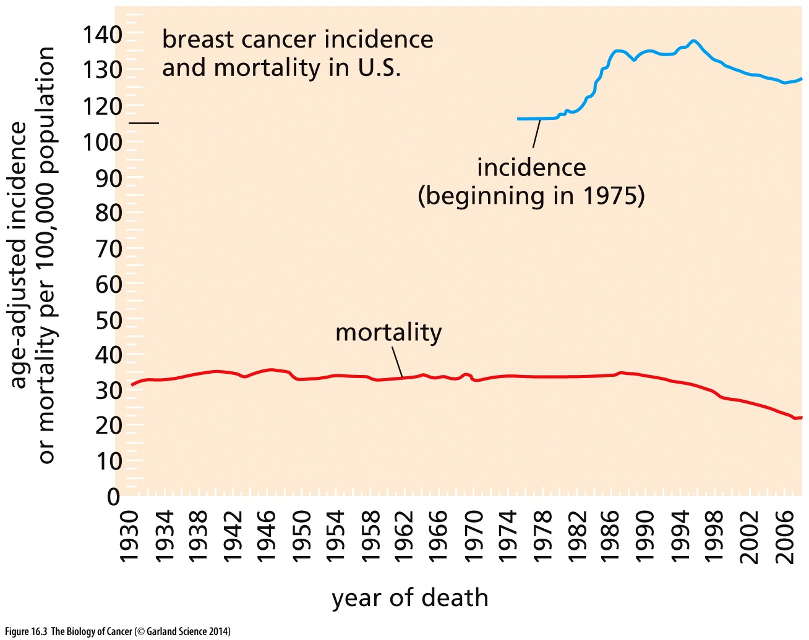
Figure 16.3 Breast cancer incidence vs. mortality in the United States
The age-adjusted incidence of breast cancer has been increasing steadily over the past several decades, while mortality from this disease was quite constant until the end of the twentieth century, when it began to decline significantly. Most of the increase in incidence appears to be attributable to increased screening, but a small proportion of it may be due to real changes in the rate at which the disease strikes because of changes in reproductive practices, nutrition, obesity, age of menarche and menopause, and so forth.(From A. Jemal et al., CA Cancer J. Clin. 55:10–30, 2005.)
Notes:
早期诊断，是福音还是烦恼？

Slide 6
16.1 The development and clinical use of effective therapies will depend on accurate diagnosis of disease

Slide 7
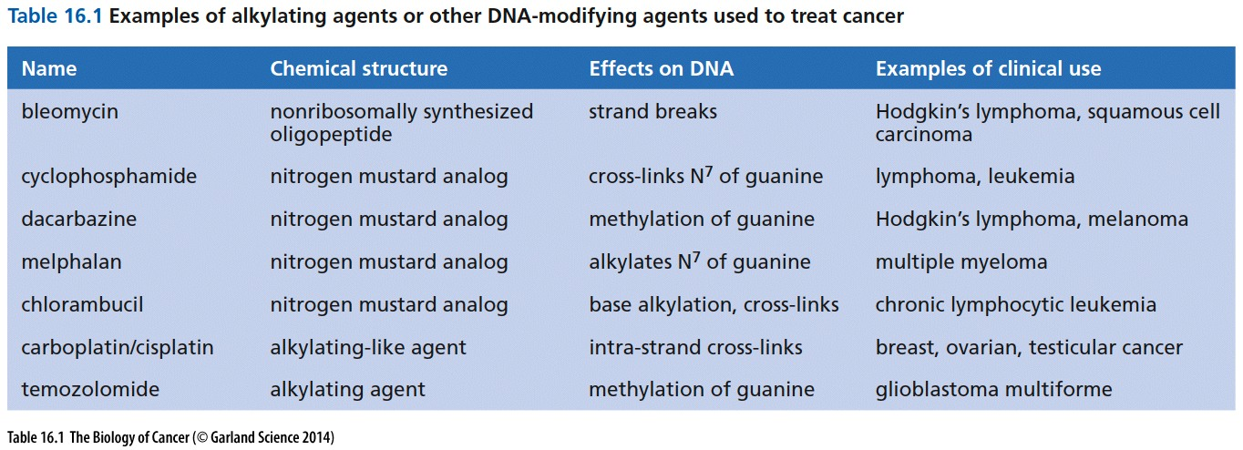
In the case of breast cancers, there has been a crying need to distinguish those primary
tumors that are likely to become metastatic from those that will remain indolent and
are therefore not likely to spread during the lifetime of the patient.

Slide 8
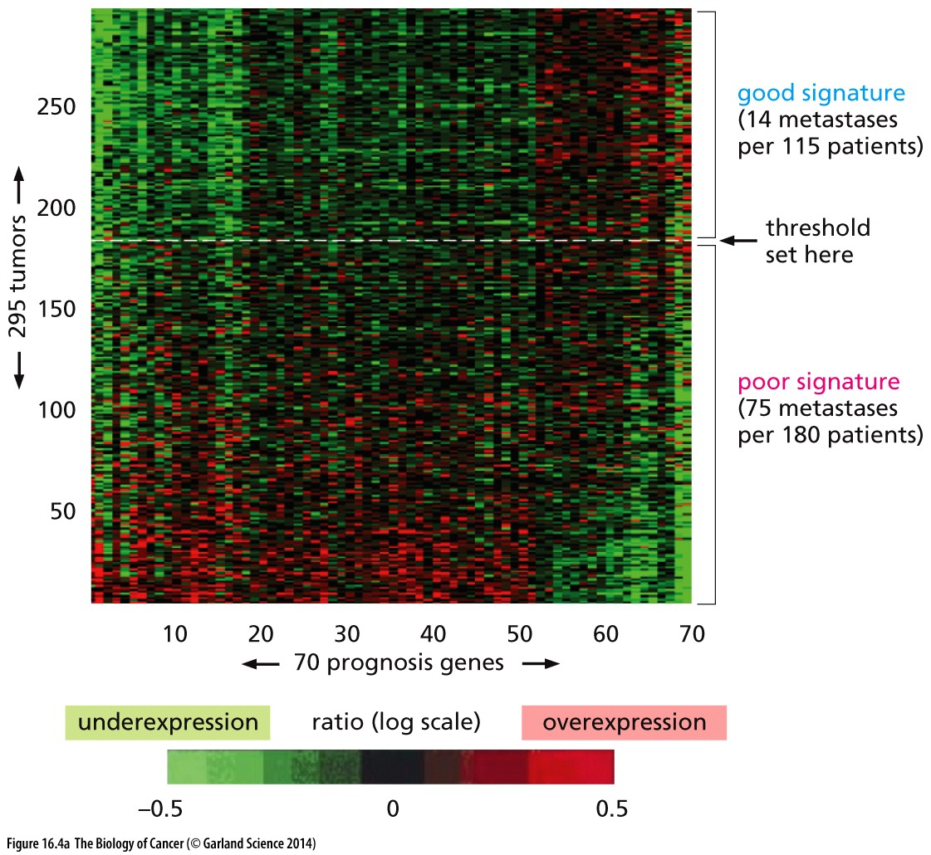
Figure 16.4 Stratifying breast cancers using functional genomics
(A) Expression arrays were used to analyze the gene. Bioinformatics analyses of these tumors were then employed to choose a set of 70 “prognosis genes” whose expression could be used to stratify these breast cancer patients. The expression levels of these 70 genes together with information about the patients’ clinical history was then used to set a threshold that separated tumors that had a “good expression signature” from tumors that had a “poor expression signature.”

Slide 9
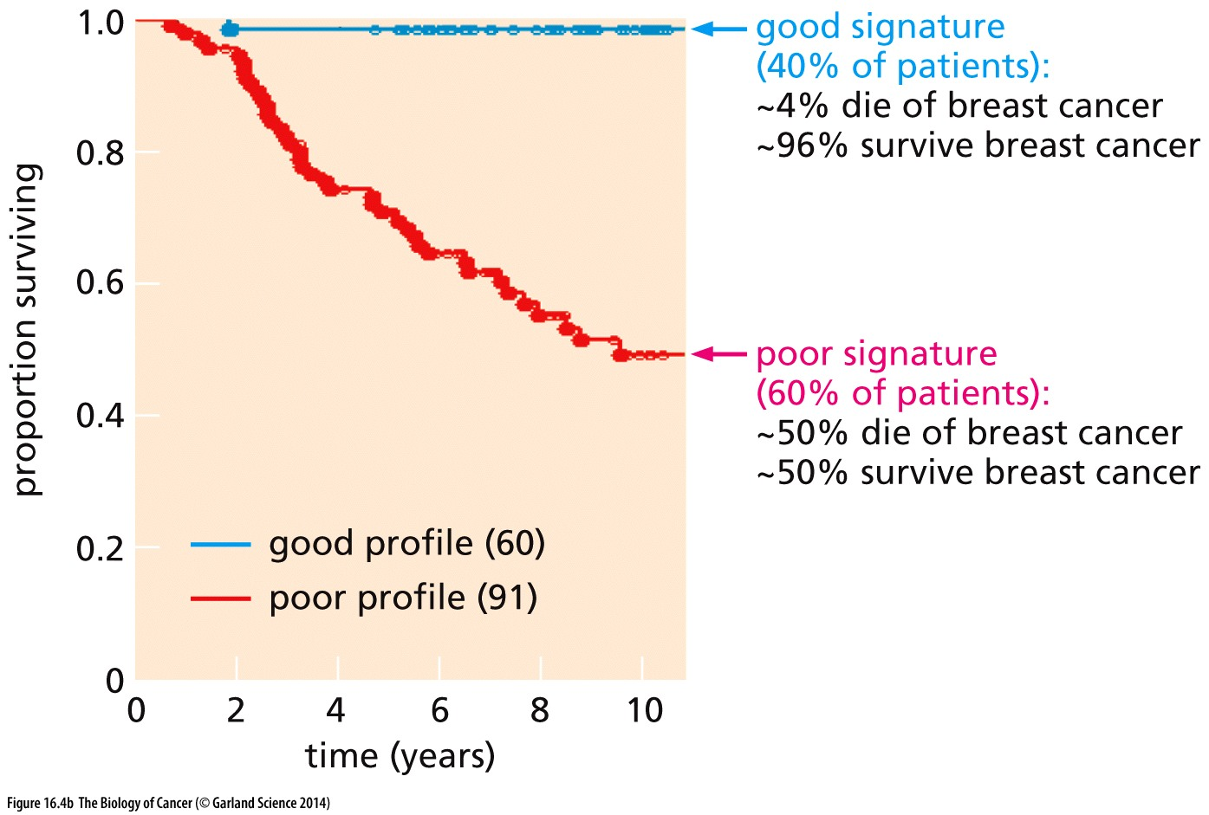
Figure 16.4 Stratifying breast cancers using functional genomics
(B) This Kaplan–Meier plot reveals the stratification of a group of 151 breast cancer patients whose survival had been followed for 10 years following initial diagnosis. Using the criteria of panel A, they could be separated into two groups with dramatically different clinical courses. Taken together with other factors (such as the efficacy of chemotherapy), calculations indicate that women whose tumors carry a good expression signature derive virtually no benefit from adjuvant（辅佐的）chemotherapy.

Slide 10
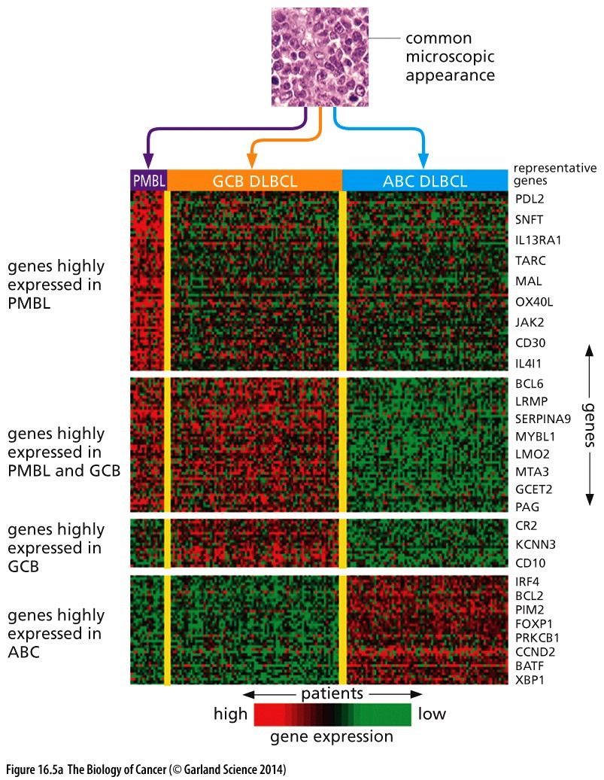
Figure 16.5 Stratification of diffuse large B-cell lymphomas
(A) DLBCLs represent a group of several subtypes of B-cell neoplasia that are essentially indistinguishable in the microscope from one another and from primary mediastinal B-cell lymphomas (above). However, use of gene expression arrays (below) allows these tumors to be stratified into three subtypes, termed primary mediastinal B-cell lymphomas (PMBLs), germinal-center B-cell (GCB) DLBCLs, and activated B-cell-like (ABC) DLBCLs. In this expression array, a set of genes whose expression levels have been found to be useful in making this stratification is plotted along the vertical axis, while a set of patient tumors (unlabeled) is plotted along the horizontal axis.

Slide 11
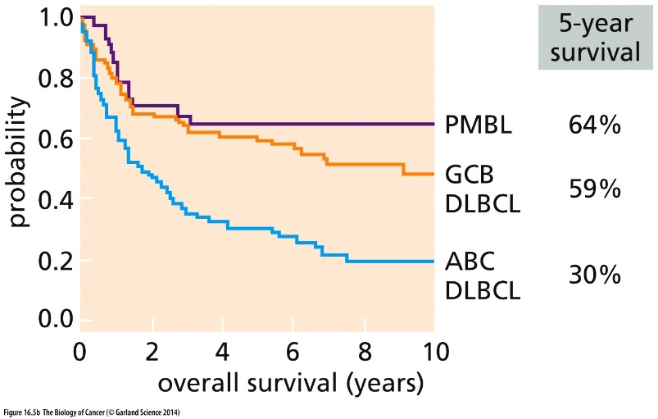
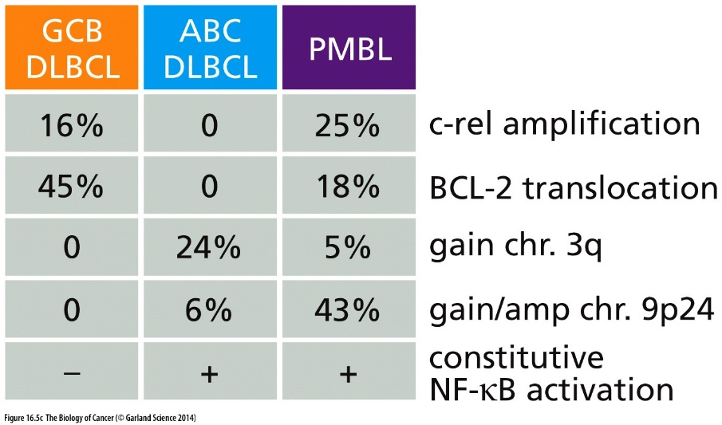
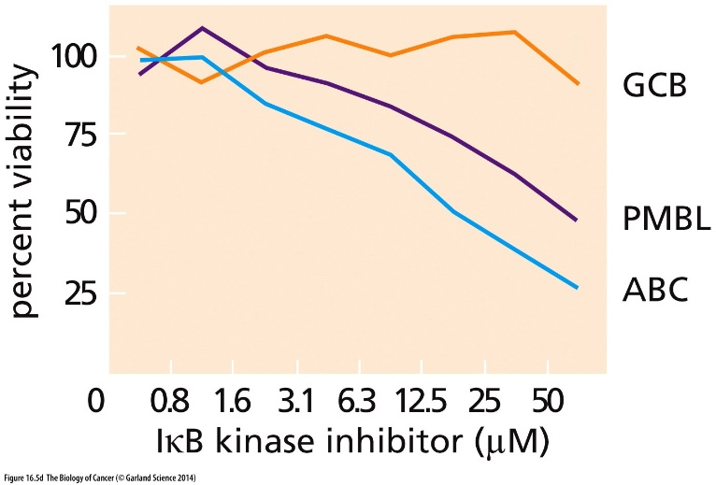
Figure 16.5 Stratification of diffuse large B-cell lymphomas

Slide 12
16.2 Surgery, radiotherapy, and chemotherapy are the major pillars on which current cancer therapies rest
Traditional cancer therapy
Surgery: since the end of 19th century
Radiotherapy: since 1900s
Chemotherapy: since World War II (1940s)

Slide 13
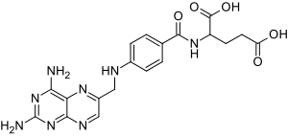
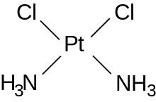
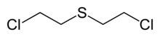
Chemotherapy history
1, 1942, Yale University, Mustard gas treatment leads to regression of lymphoma (First chemotherapy trials)
2, 1947, aminopterin, acted as an antagonist of folate metabolism. A young boy treated that year for lymphoma survived and lived another half century, representing the first documented cure of this disease. Compounds like aminopterin are often termed antimetabolites（抗代谢物）.
3, 1965, Cisplatin （顺铂）was discovered serendipitously（偶然地） as an antibacterial agent that formed at platinum electrodes and subsequently showed potent anti-cancer activity. Cisplatin can cure testicular cancer.
Mustard gas
aminopterin
Cisplatin

Slide 14
Types of Chemotherapy drugs
Antimetabolites (抗代谢物)
Antimetabolites are types of chemotherapy treatments that are very similar to normal substances within the cell. When the cells incorporate these substances into the cellular metabolism, they are unable to divide.
2. Alkylating Agents (烷化剂)
Alkylating agents modify and crosslink DNA.
Others
Antitumor Antibiotics, eg. Bleomycin
…

Slide 15
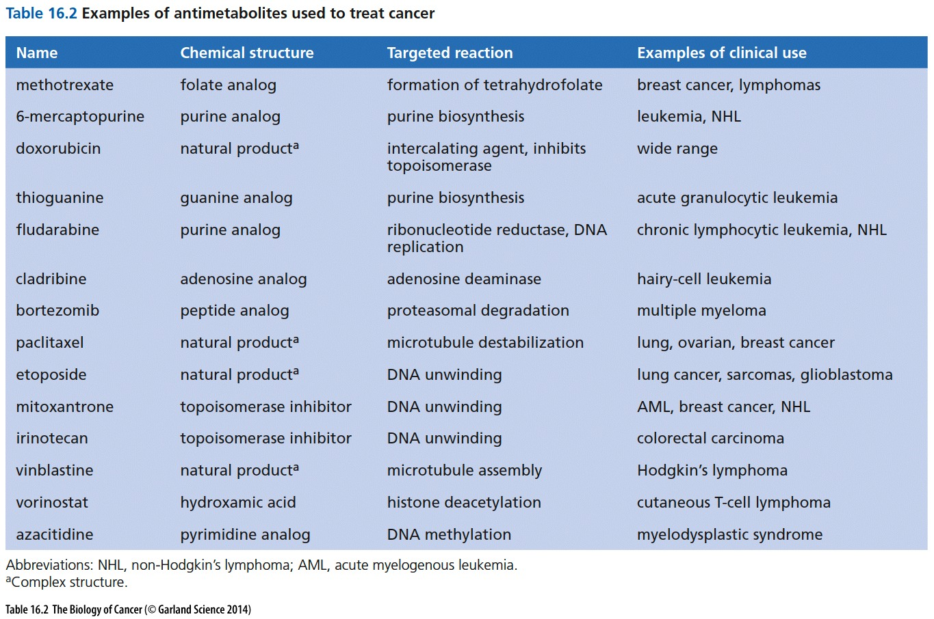
An antimetabolite is a chemical that inhibits the use of a metabolite, which is another chemical that is part of normal metabolism

Slide 16
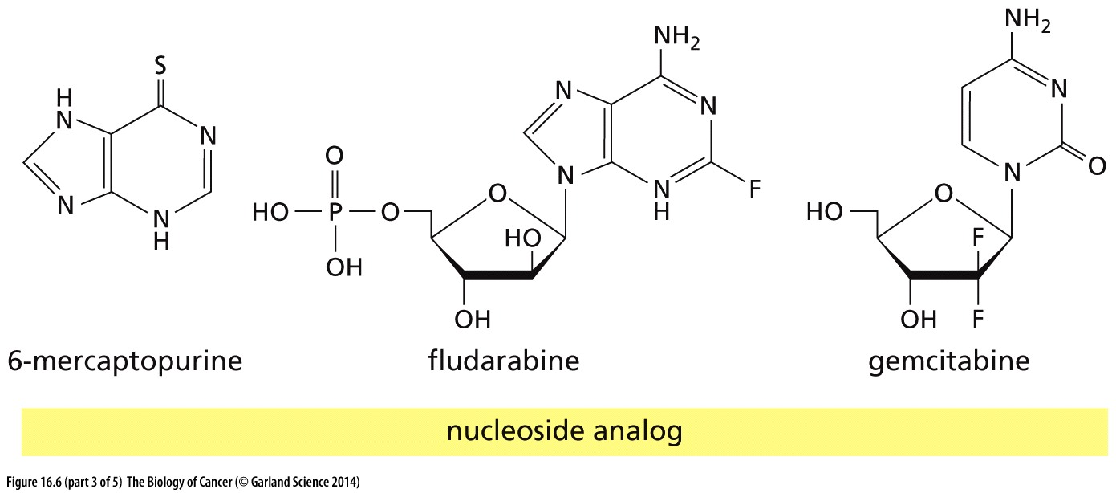
Figure 16.6 Cytotoxic drugs in current use
Antimetabolites（抗代谢物）

Slide 17
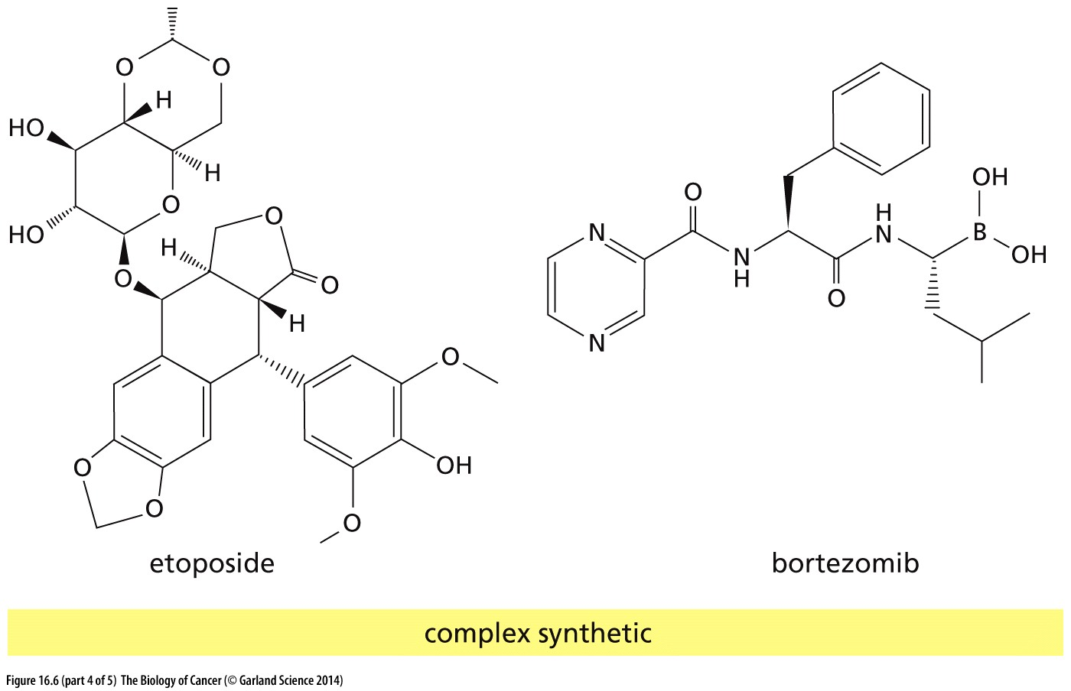
Figure 16.6 Cytotoxic drugs in current use
Etoposide forms a ternary complex with DNA and the topoisomerase II enzyme (which aids in DNA unwinding), prevents re-ligation of the DNA strands, and by doing so causes DNA strands to break.
Bortezomib (Velcade) is the first therapeutic proteasome inhibitor to be tested in humans.
Antimetabolites（抗代谢物）

Slide 18
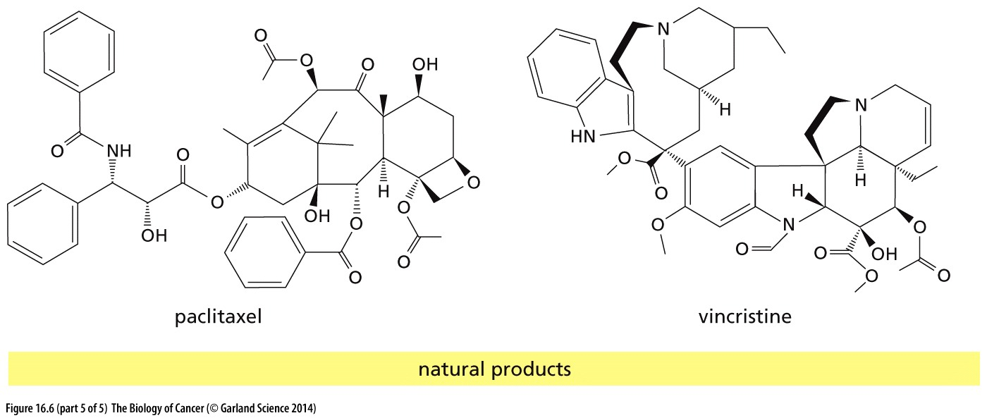
Figure 16.6 Cytotoxic drugs in current use
Paclitaxel (紫杉醇) is a chemotherapy medication used to treat a number of types of cancer. Paclitaxel stabilize microtubule structure by acting as tubulin depolymerization inhibitors.
Vincristine (长春新碱) is a chemotherapy medication used to treat a number of types of cancer. Vincristine is a Tubulin polymerization inhibitors.
Antimetabolites（抗代谢物）

Slide 19
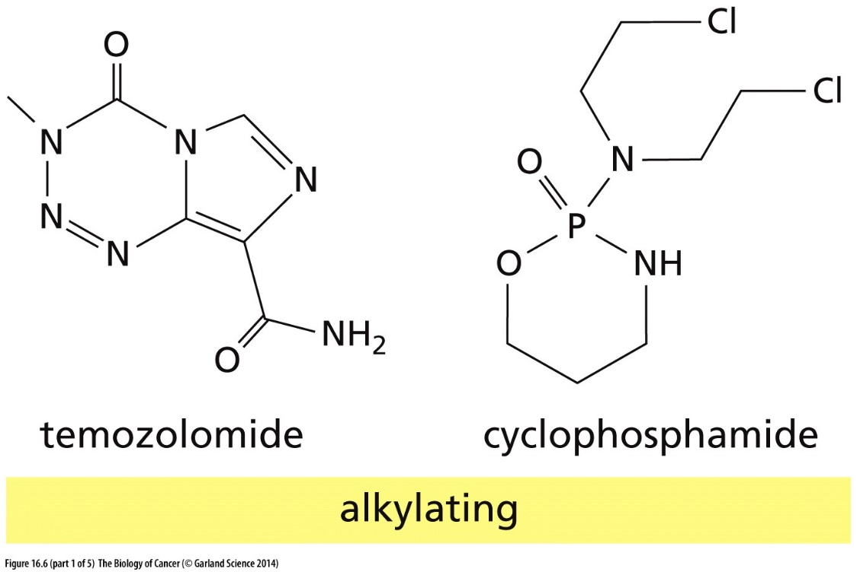
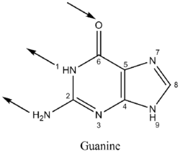
Figure 16.6 Cytotoxic drugs in current use
Alkylating: alkyl group (CnH2n+1) is attached to the guanine base of DNA, at the number 7 nitrogen atom of the purine ring
烷基化
Notes:
烷化剂共价修饰DNA，从而抑制了DNA复制，细胞增殖。The 7-nitrogen atom of guanine is particularly susceptible to the formation of a covalent bond with alkylating agents

Slide 20
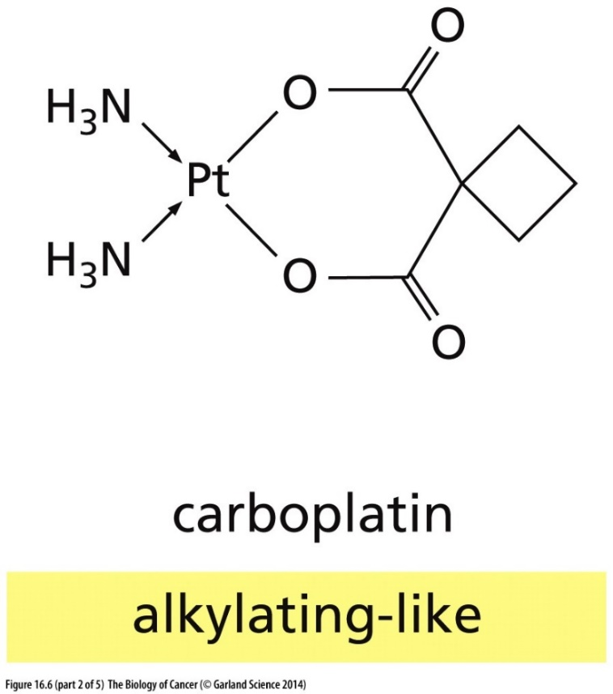
Figure 16.6 Cytotoxic drugs in current use
Cisplatin

Slide 21
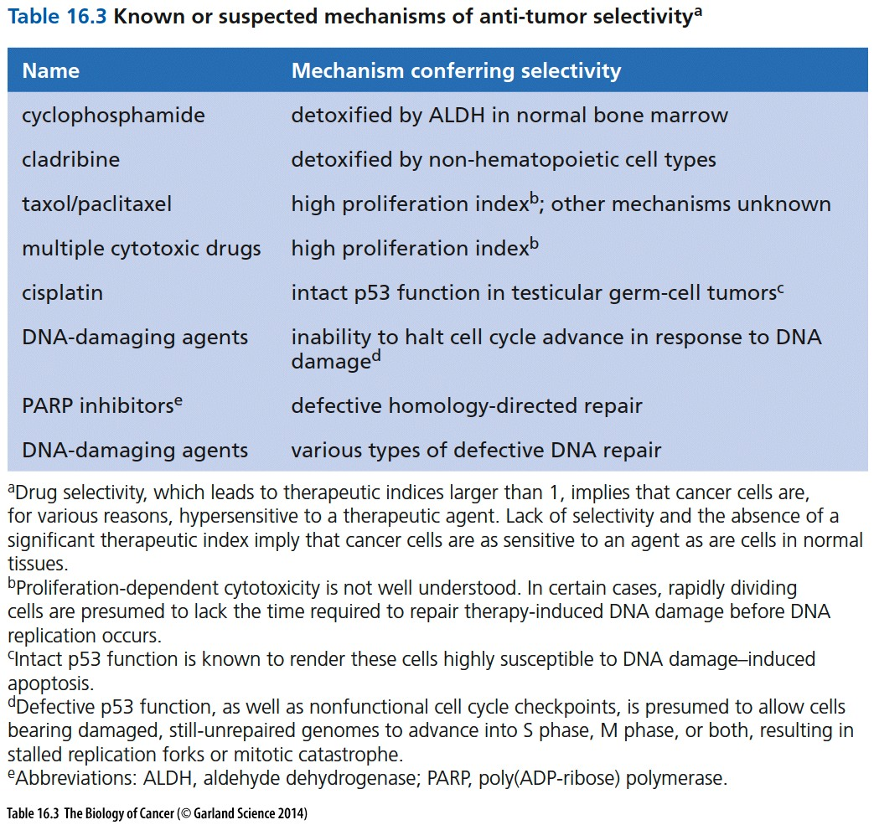

Slide 22
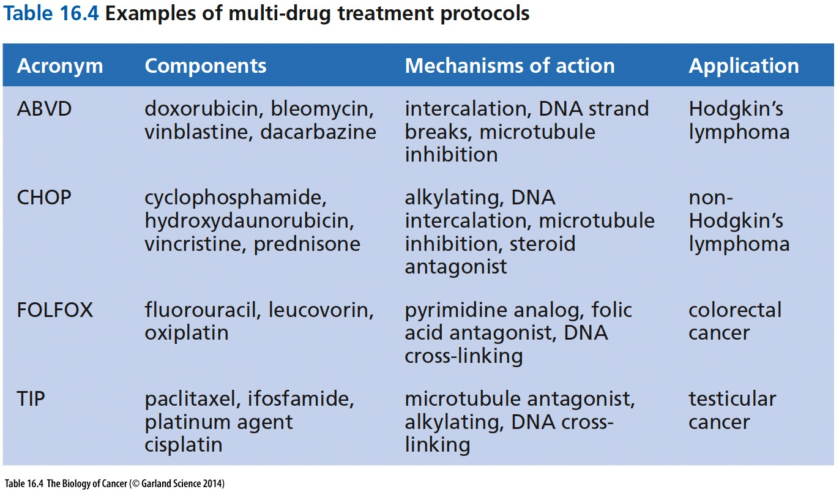

Slide 23
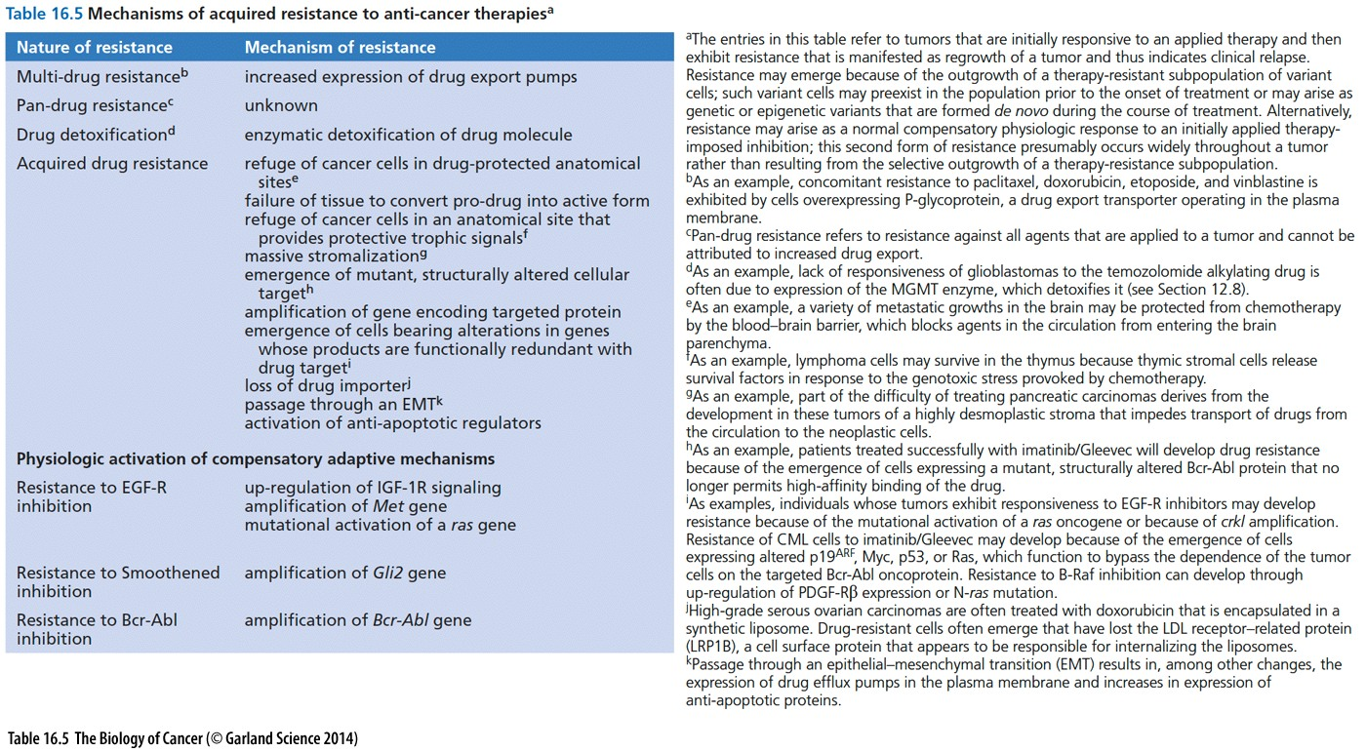

Slide 24
Acute promyelocytic leukemia (APL): from highly fatal to highly curable
Acute promyelocytic leukemia (急性早幼粒细胞白血病) was first described in 1957 as “a very rapid fatal course of only a few weeks’ duration,” “seems to be the most malignant form of acute leukemia.”
In 1973, Bernard et al demonstrated that APL leukemic cells were relatively sensitive to chemotherapy (CT: daunorubicin) that yielded a complete remission (CR) rate of 19 (55%) in 34 patients with APL.
In 1985, the introduction of all-trans retinoic acid (ATRA) opened a new page in the history of APL treatment (王振义，陈竺). Optimization of the ATRA-based regimens combining ATRA and CT has further raised the CR rate up to 90% to 95%, and a 6-year DFS up to 86% ( 10%) in low-risk patients in a report (Table 1).
Since mid-1990s, arsenic trioxide + ATRA (王振义，陈竺), 10-year survival rate was estimated to be approximately 77%.
Notes:
急性早幼粒细胞白血病主要发生于年轻人，病程发展快，若不治疗病人常于半年内死亡。

Slide 25
16.3 Differentiation, apoptosis, and cell cycle checkpoints can be exploited to kill cancer cells
The prominent exception has been one form of treatment of acute promyelocytic leukemia (APL,急性早幼粒细胞白血病). In the course of this therapy, the undifferentiated leukemic blast cells can be induced to differentiate into neutrophils by treatment with all-trans-retinoic acid (ATRA; Figure 16.7B). Treatment of APL patients with ATRA together with concomitant chemotherapy often results in complete remissions, with 5-year survival rates approaching 75 to 85%—suggestive of complete cures.
A complementary treatment derives from the use of arsenic trioxide, first discovered in China, which also drives degradation of PML-RARα; when applied together with ATRA, the two agents achieve a greater than 90% cure rate of APLs. Arsenic is usually portrayed as a highly toxic poison, whereas in this case it is clearly a remarkable lifesaver!
10-year survival rate was estimated to be approximately 77%
上海血研所，王振义，陈竺

Slide 26
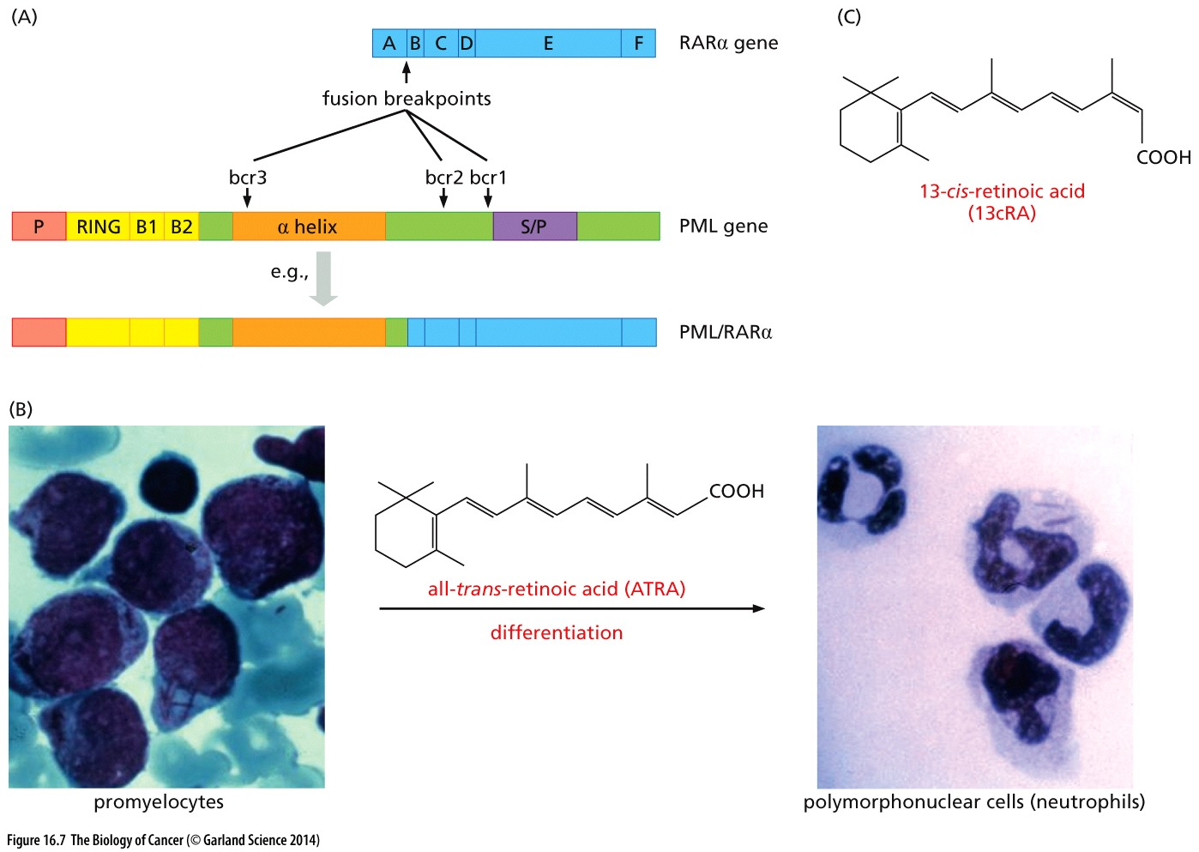
Figure 16.7 Retinoic acid and induced differentiation of cancer cells
PML-RARα fusion protein

Slide 27
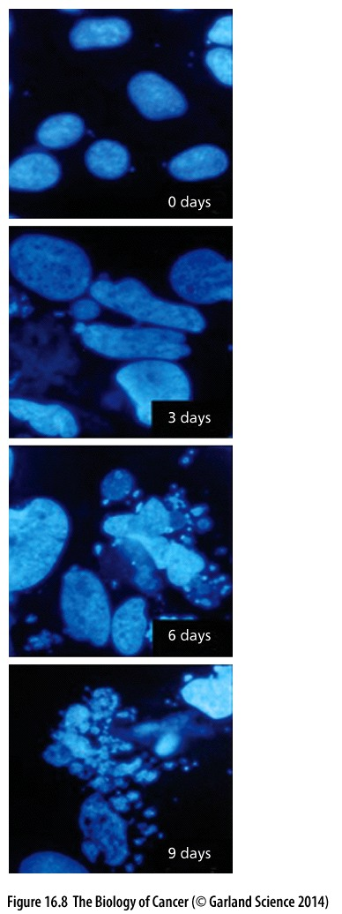
Figure 16.8 Chemotherapy and mitotic catastrophe
Many chemotherapeutic drugs may damage the chromosomes of cancer cells.
Because some cancer cells lack key G2/M checkpoint controls, they may
advance into mitosis without having repaired the chromosomal damage.
This may cause them to enter into “mitotic catastrophe” that results
in aneuploidy, polyploidy, formation of micronuclei, and the eventual
death of these cells. Seen here are the effects of low doses (50 ng/ml)
of doxorubicin, a widely used chemotherapeutic drug, on Huh-7 human
hepatoma cells. Over a period of 9 days, the nuclei of these cells grow
larger or smaller and many eventually fragment into micronuclei, each
of which carries a small number of chromosomes; this leads eventually
to cell death, often by apoptosis.

Slide 28
16.4 Functional considerations dictate that only a subset of the defective proteins in cancer cells are attractive targets for drug development

Slide 29
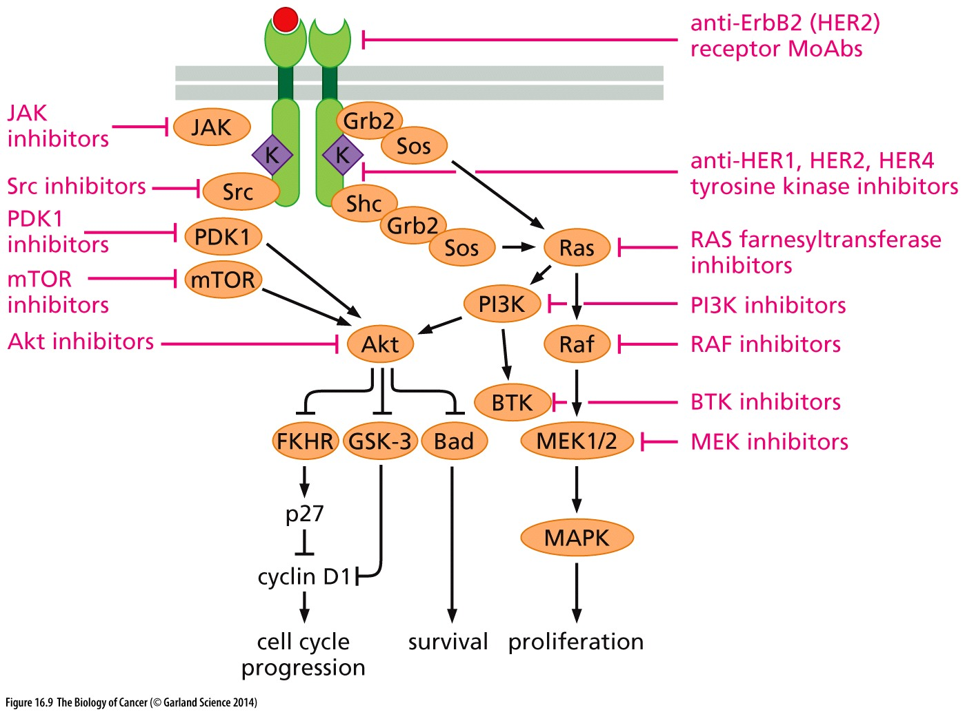
Figure 16.9 Inhibition of tumor growth by targeting downstream signaling elements

Slide 30
Oncogene addiction
This continued dependence on an oncogene, often an initiating oncogene, has been termed oncogene addiction to indicate the irreplaceable role that such a gene plays in the ongoing viability of the cancer cell and growth of the tumor.

Slide 31
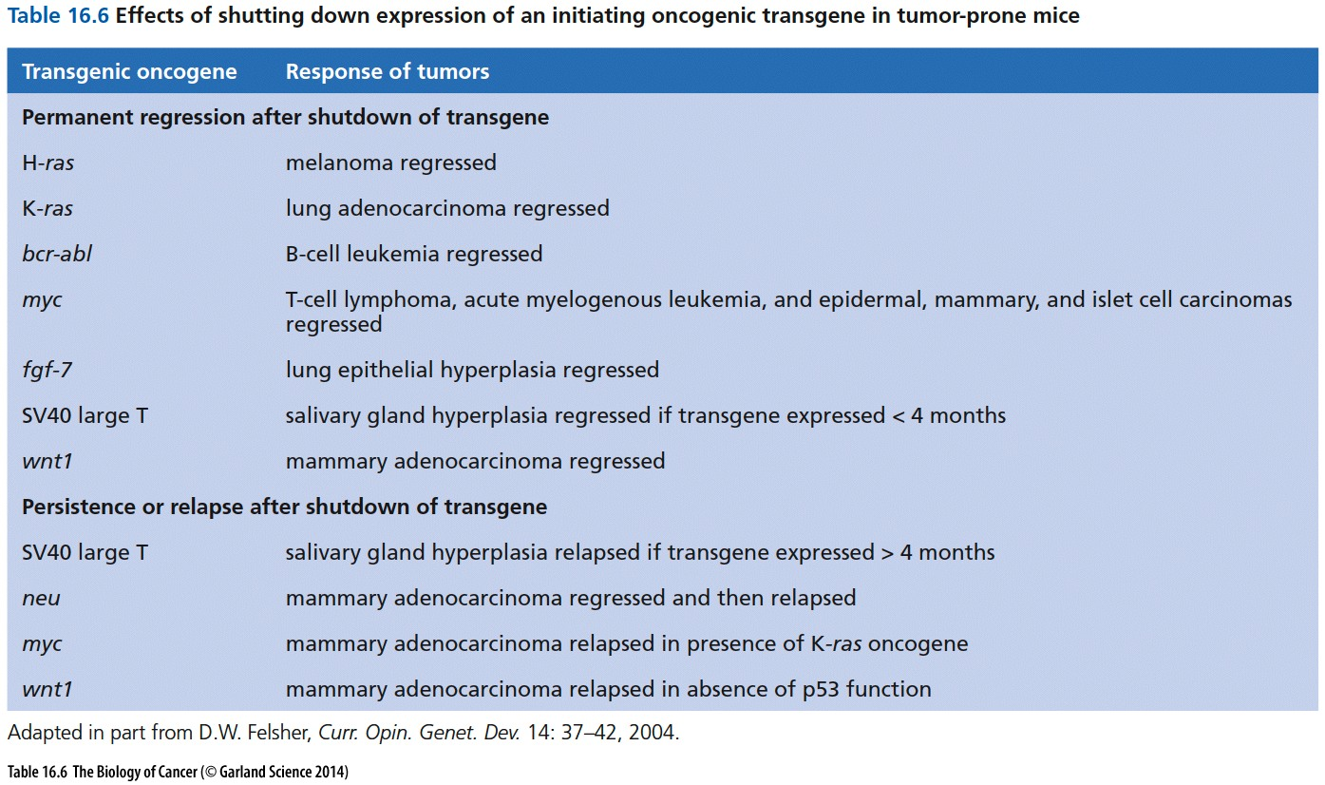

Slide 32
Druggable target
A protein is considered druggable if it has a cavity, usually a well-defined catalytic
cleft; Hence transcription factor oncoproteins, such as Myc and Fos, are placed in the category of undruggable targets while the many kinases involved in cancer formation are placed in the camp of druggable target molecules
Ras has a clearly identifiable catalytic activity—its GTPase function. This enzymatic activity in Ras-expressing cells has never been the object of drug development, because the Ras GTPase functions as a negative regulator of Ras signaling. Its inhibition would only augment the already-disastrous effects of the amino acid substitutions that create Ras oncoproteins in the first place. The same can be said of many tyrosine phosphatases, whose designated roles are to reverse the effects of growth-promoting tyrosine kinases, and, similarly, the activity of the PTEN phosphatase, which serves to counteract PI3K.

Slide 33
Druggable target
Cell surface receptor
Enzyme
Tyrosine kinases are major druggable targets in cancer
替尼类药物, 如 imatinib, gefitinib, erlotinib
Tyrosine kinase inhibitor (-tinib)
RAS, PTEN typically are not druggable target

Slide 34
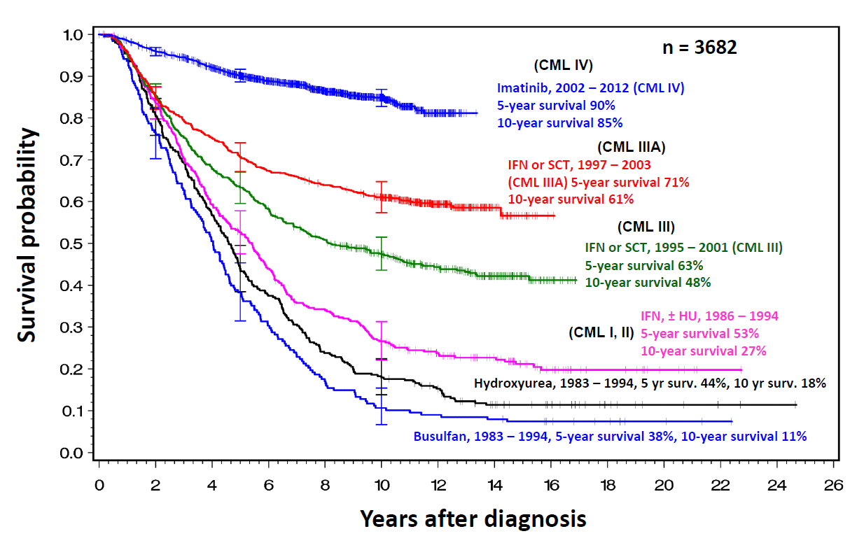
Gleevec/Imatinib and the cure of CML
myelogenous leukemia (慢性髓细胞性白血病) (CML)
Imatinib/Gleevec is the first and classical success of targeted therapy.

Slide 35
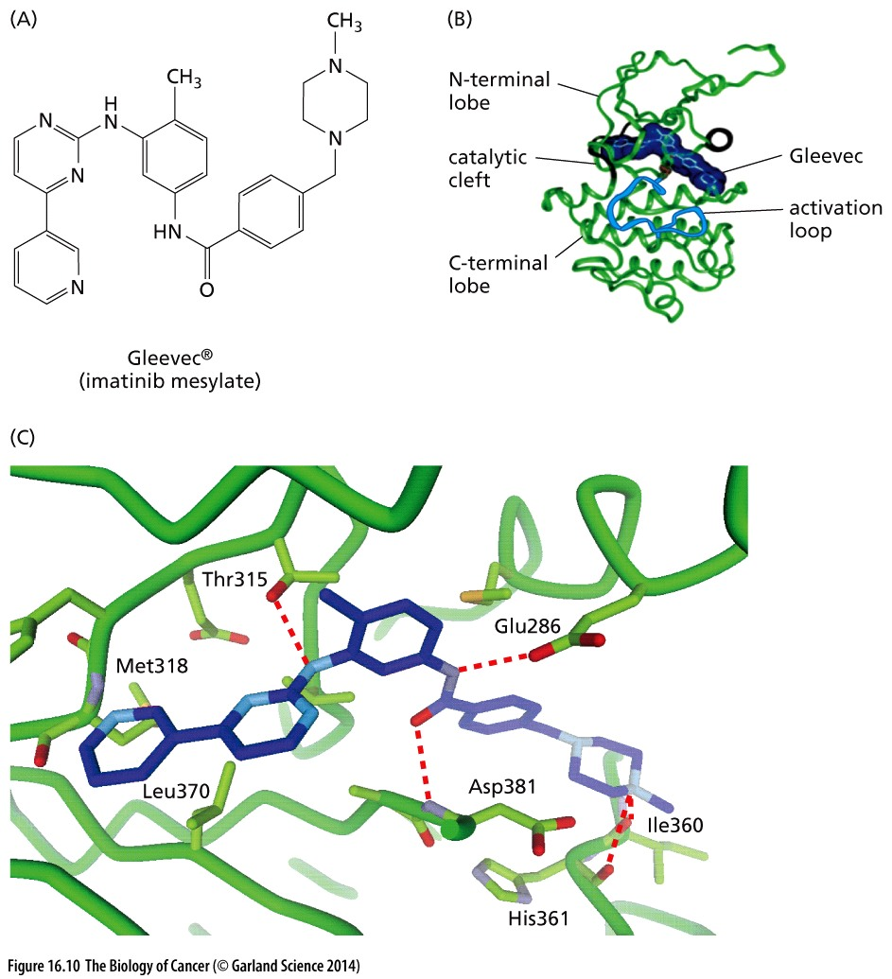
Figure 16.10 Multiple contacts between drugs and their targets
Imatinib/Gleevec and Abl kinase

Slide 36
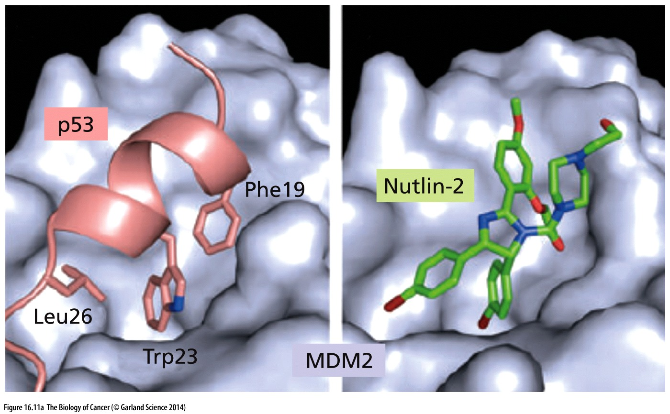
Figure 16.11 Inhibitors of protein–protein interactions
(A) A search for compounds that inhibit Mdm2–p53 binding resulted in the discovery of Nutlin-2, which associates with the p53- binding pocket of Mdm2, whose surface is shown here. The usual interaction of the transactivation domain of p53 with a hydrophobic cleft near the N-terminal domain of MDM2 is mimicked by the Nutlin-2 molecule binding the same hydrophobic cleft of MDM2. Nutlin-2 and closely related compounds prevent Mdm2- mediated p53 degradation and thereby act to trigger apoptosis in certain cancer cells, achieving both effects at low micromolar concentrations.

Slide 37
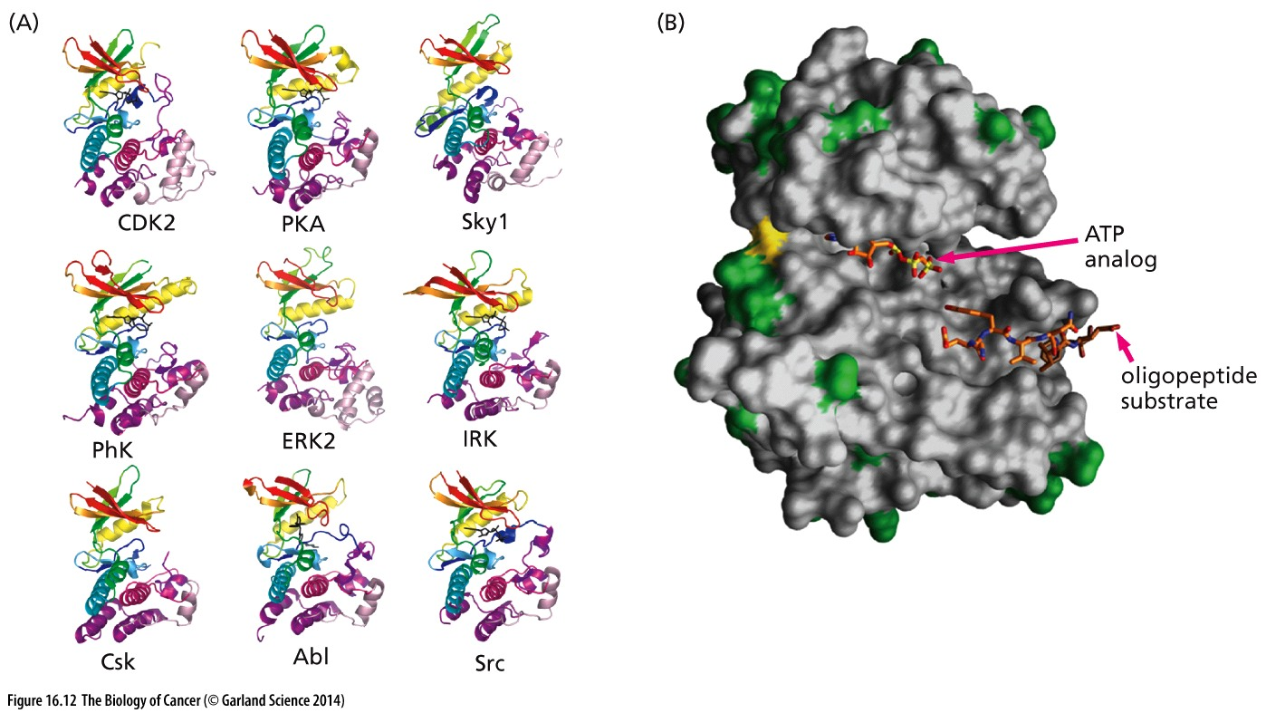
Figure 16.12 Similar structures of kinases
Because almost all protein kinases are evolutionarily related, their catalytic clefts are structurally quite similar (Figure 16.12A). The similarity is even more striking among the clefts of the more closely related tyrosine kinases, which are involved in cancer pathogenesis. How can one possibly develop agents that affect the actions of certain cancer-associated kinases, while leaving untouched the kinases required for normal cell proliferation and survival?
Tyrosine kinases are major druggable targets in cancer

Slide 38
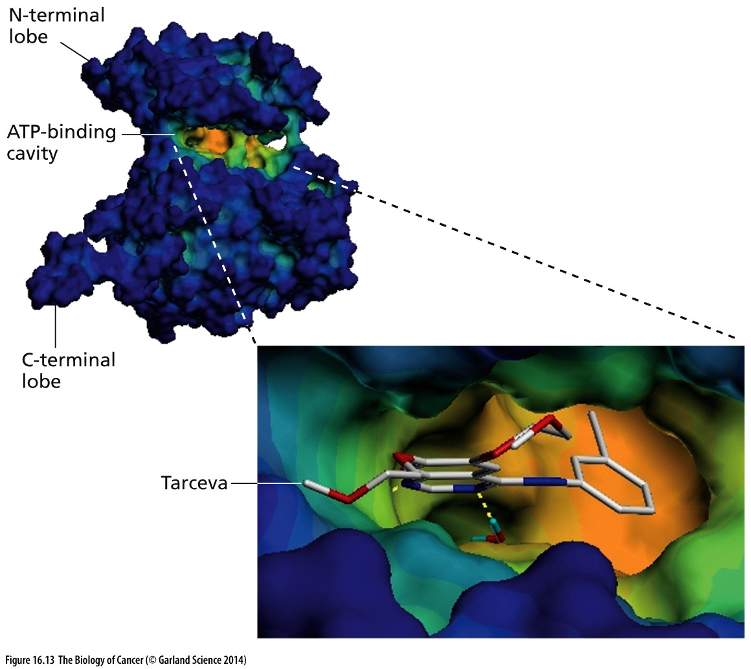
Figure 16.13 Tarceva and the inhibition of the EGF receptor kinase domain
This space-filling model of the catalytic cleft of the EGF receptor tyrosine kinase (TK) domain, derived by X-ray crystallography, shows how the drug Tarceva fits snugly within the ATP-binding cavity of the cleft and in this way inhibits receptor signaling.

Slide 39
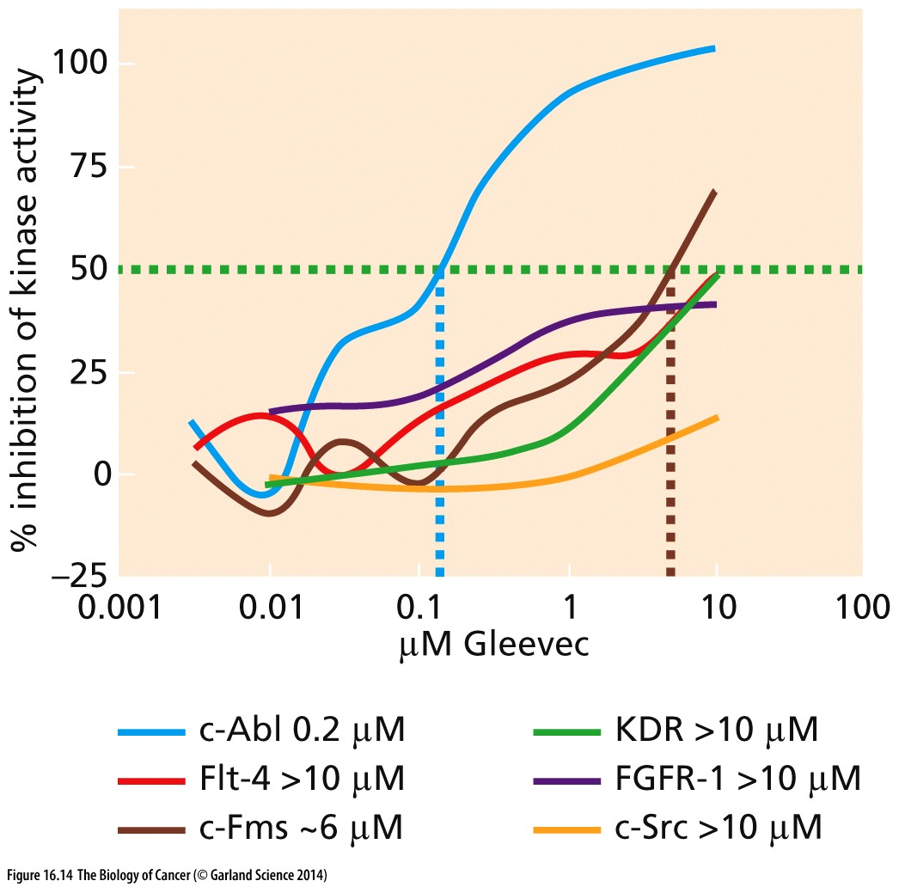
Figure 16.14 Dose response curves of Gleevec
The ability to inhibit a targeted protein without affecting other, related cellular proteins is critical to the success of therapy, making possible therapeutic responses without undesired side-effect toxicities. Here we see the responses of a group of six tyrosine kinase (TK) enzymes to the drug Gleevec.
Imatinib/Gleevec and Abl kinase

Slide 40
16.7 Drug candidates must be tested on cell models as an initial measurement of their utility in whole organisms

Slide 41
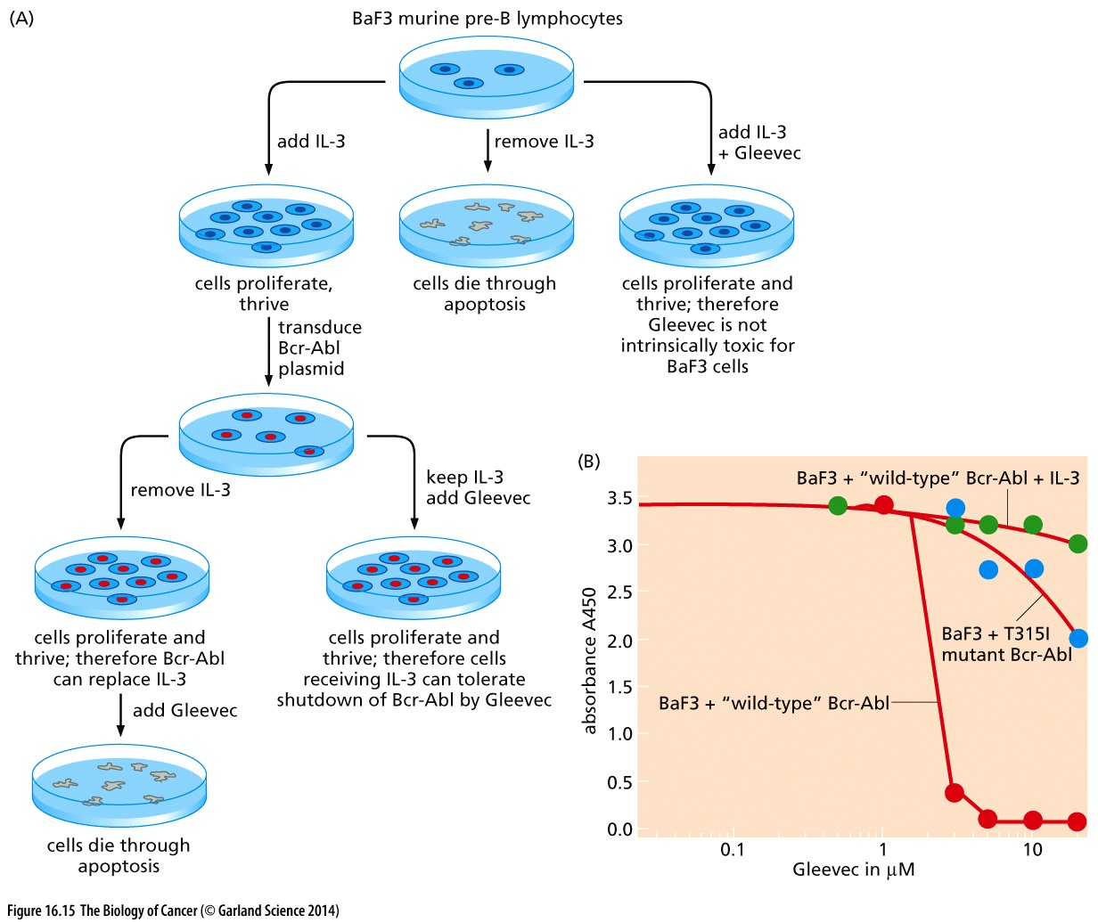
Figure 16.15 Testing of Gleevec in cell culture
Imatinib/Gleevec and Abl kinase
Notes:
具体过程仅供参考

Slide 42
16.9 Promising candidate drugs are subjected to rigorous clinical tests in Phase I trials in humans
Phase I trials: Testing for drug’s tolerability on healthy volunteers

Slide 43
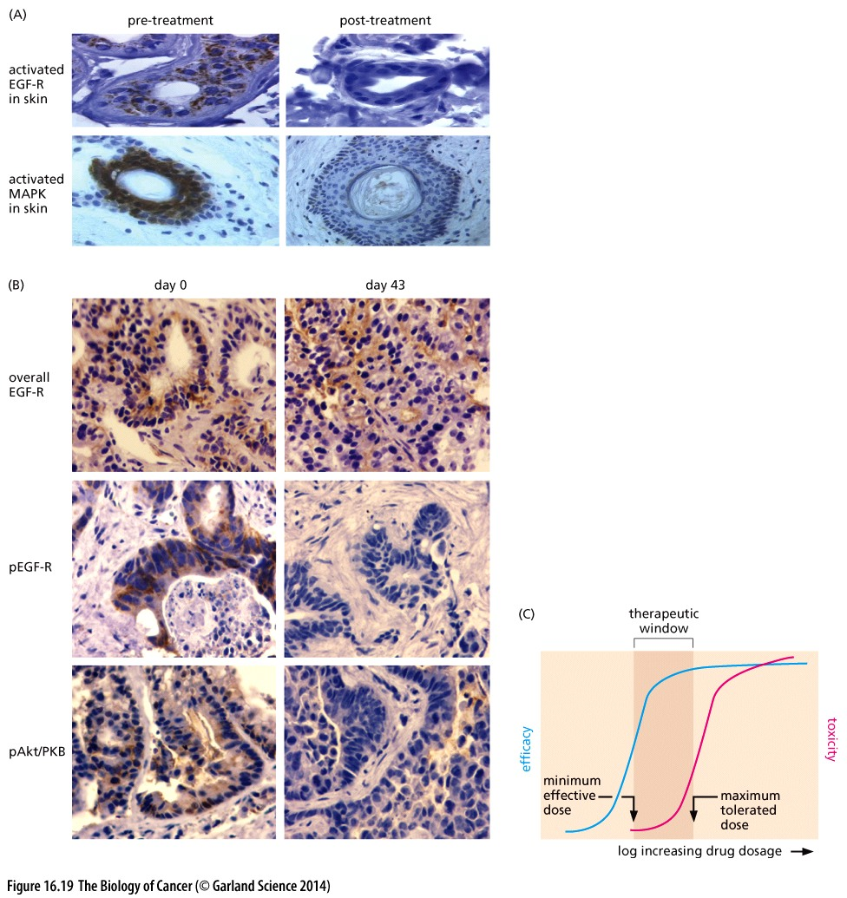
Figure 16.19 Measurements of pharmacodynamics and determination of the therapeutic window
Phase I clinical trial

Slide 44
16.10 Phase II and III trials provide credible indications of clinical efficacy

Slide 45
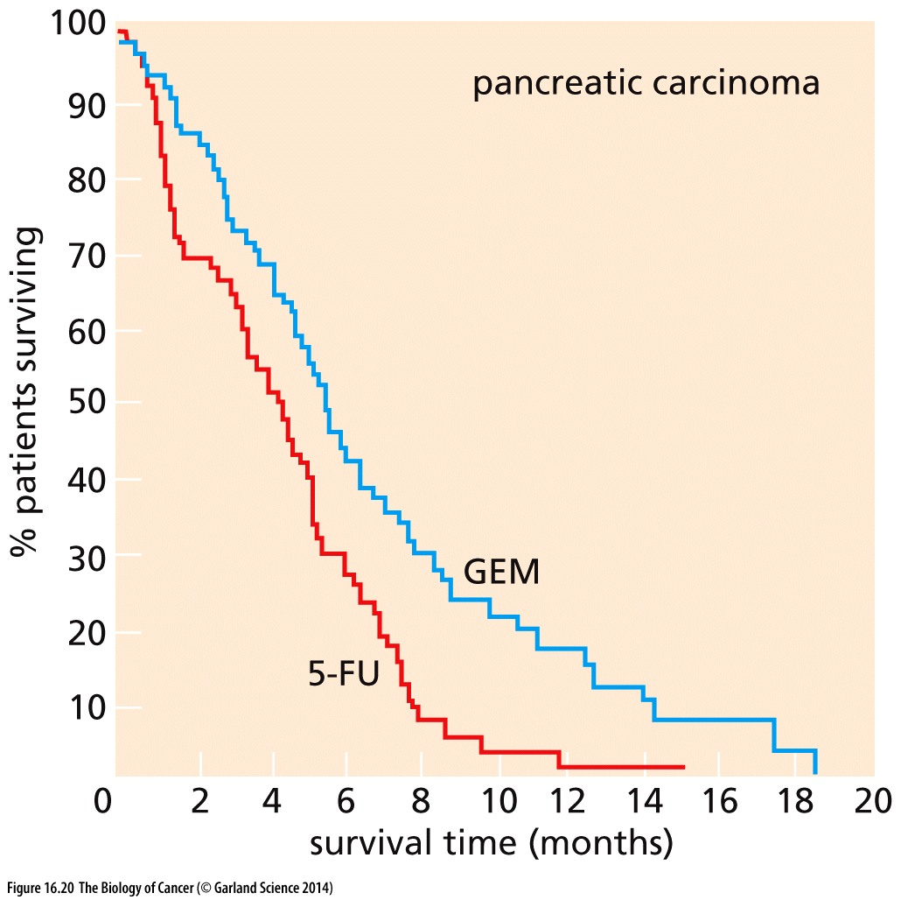
Figure 16.20 Gemcitabine as a treatment for pancreatic cancer
This Kaplan–Meier plot illustrates the high mortality exacted by pancreatic cancer.
Patients treated with gemcitabine (GEM) lived slightly longer than those treated with 5-fluorouracil (5-FU)—the standard treatment in the 1990s. Both of these agents are pyrimidine derivatives whose cytotoxicity derives from their ability to inhibit DNA synthesis, in part through misincorporation into the DNA. (5-FU also interferes with pyrimidine biosynthesis.) As is apparent, gemcitabine treatment offered only a modest increase in patient survival in this study reported in 1997, but this sufficed to allow its approval by the U.S. Food and Drug Administration.
GEM is Antimetabolites（抗代谢物）, see Figure 16.6

Slide 46
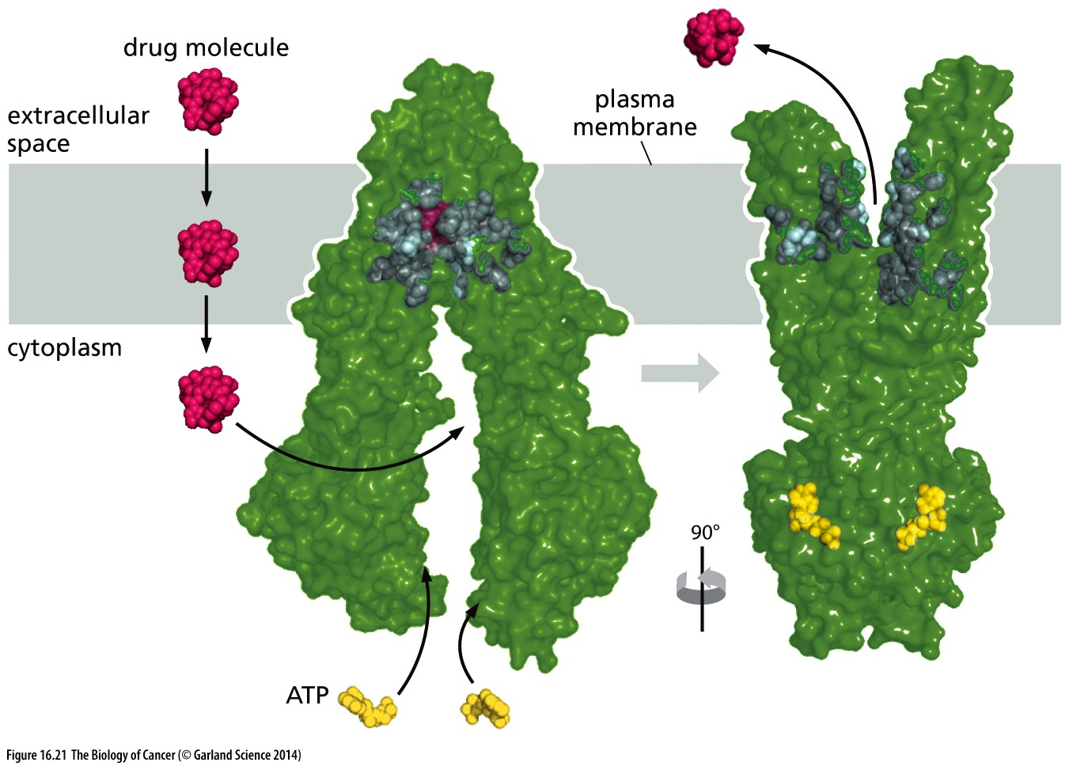
Figure 16.21 Multi-drug resistance and the P-glycoprotein
A structural model of P-gp is shown here. It is a 170-kD ATP-dependent transmembrane protein that can pump out of cells a wide variety of molecules with molecular weights ranging from 330 up to 4000. Its elevated expression is often associated with and likely causes multi-drug resistance. It is a member of a large family of mammalian ABC (ATPbinding cassette) transporter molecules,of which 49 have been discovered.

Slide 47
16.12 Gleevec paved the way for the development of many other highly targeted compounds
In 1960, two cytologists working in Philadelphia noted that an abnormal, unusually small Chromosome 22 was characteristically present in the great majority (>95%) of cells of chronic myelogenous leukemia (慢性髓细胞性白血病) (CML).
1982, Bcr-Abl fusion protein was identified.
Early 1990s, Bcr-Abl inhibitor imatinib was discovered. Imatinib/Gleevec was approved by FDA in 2001.
Before 2001, less than 30% CML patients can survive for more than 5 years, now with Gleevec, most if not all CML patients can survive more than 5 years.
Imatinib/Gleevec is the first and classical success of targeted therapy.
Notes:
Imatinib/Gleevec可以说是治愈了CML.
慢性髓细胞白血病是我国慢性白血病的主要病种，约占慢性白血病的70%。本病主要见于成人，随年龄增长而发病增多，也是老年人白血病的主要病种。男性多于女性，二者的比例为1.4∶1。慢性髓细胞白血病发展缓慢，病程长达数年，未经治疗的自然病程为3年左右。大多数病例经慢性期、加速期，最后进入急变期转化为急性白血病而死亡。

Slide 48
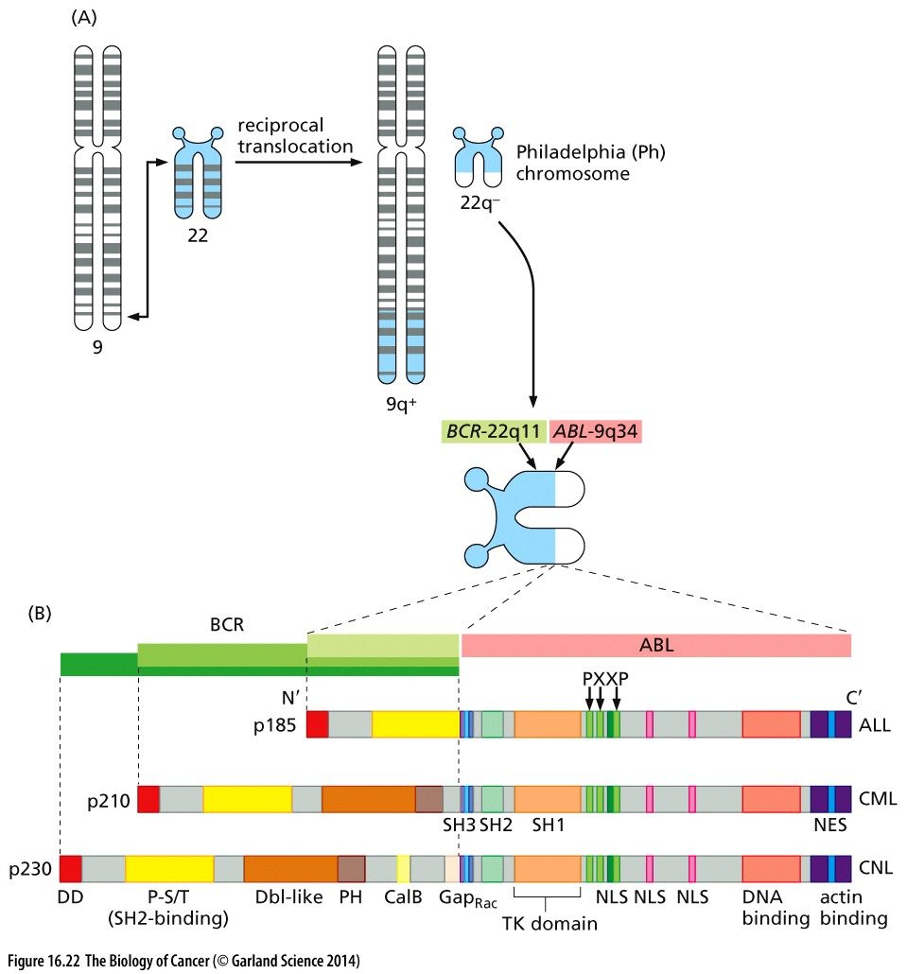
Figure 16.22 Origin and
structure of the Bcr-Abl protein
Bcr-Abl is constitutively active Abl kinase

Slide 49
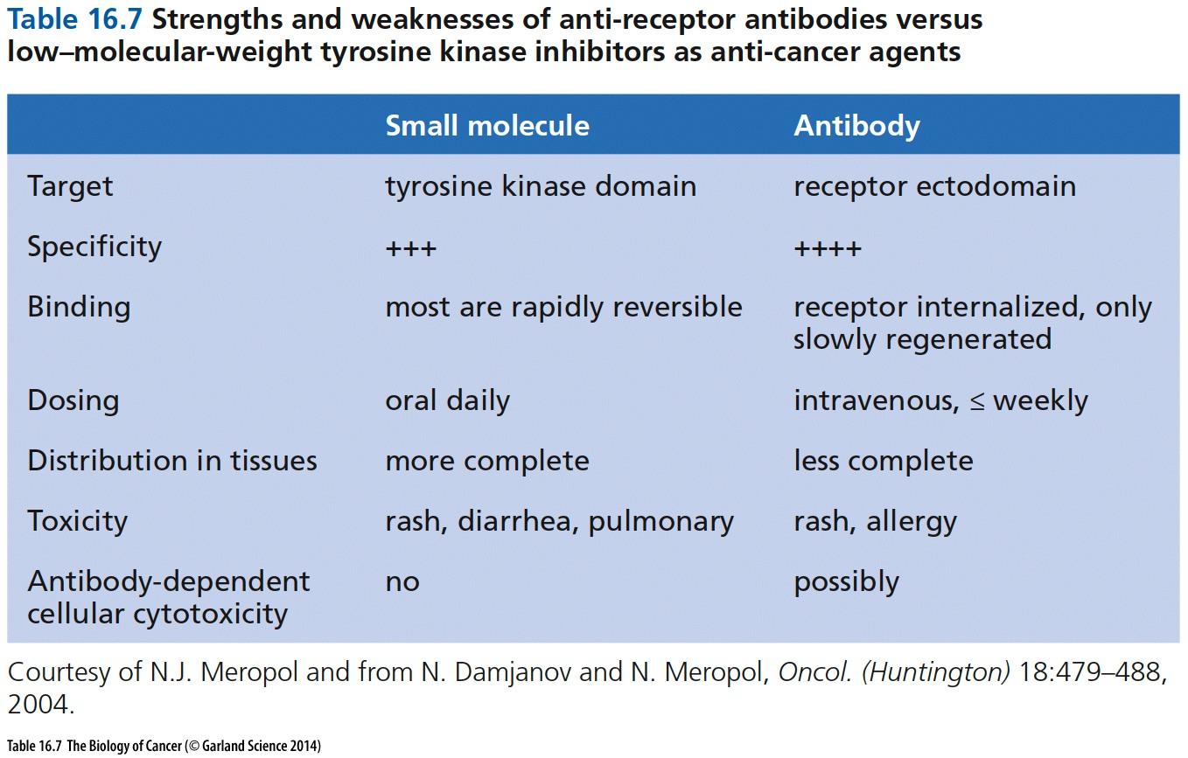

Slide 50
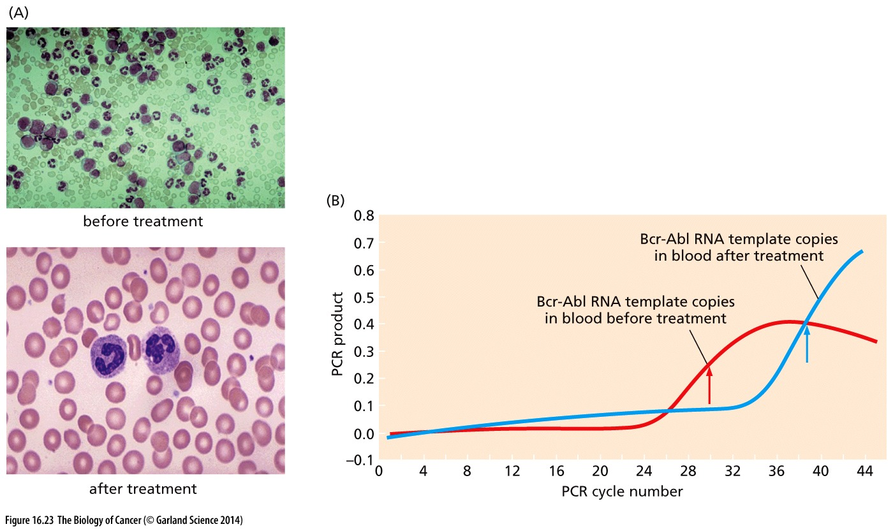
Figure 16.23 Measuring clinical responses to Gleevec treatment

Slide 51
16.13 EGF receptor antagonists may be useful for treating a wide variety of tumor types
Notes:
Imatinib传奇式成功带动了其他替尼类药物的研发热潮，如EGFR抑制剂

Slide 52
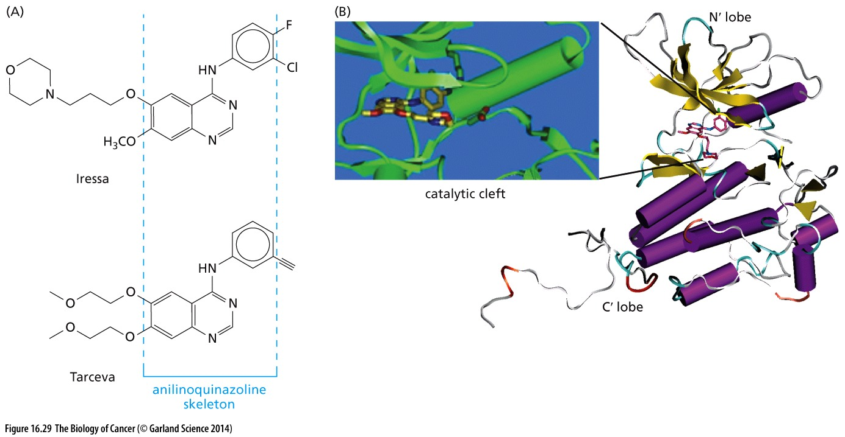
Figure 16.29 Iressa and Tarceva
The best-characterized inhibitors of the EGF-R tyrosine kinase are the drugs Iressa, also known as gefitinib and ZD1839; and Tarceva, also called either erlotinib or OSI-774 (Figure 16.29A). The two drugs have very similar but not identical properties and act by blocking the ATP-binding site of the receptor-associated kinase

Slide 53
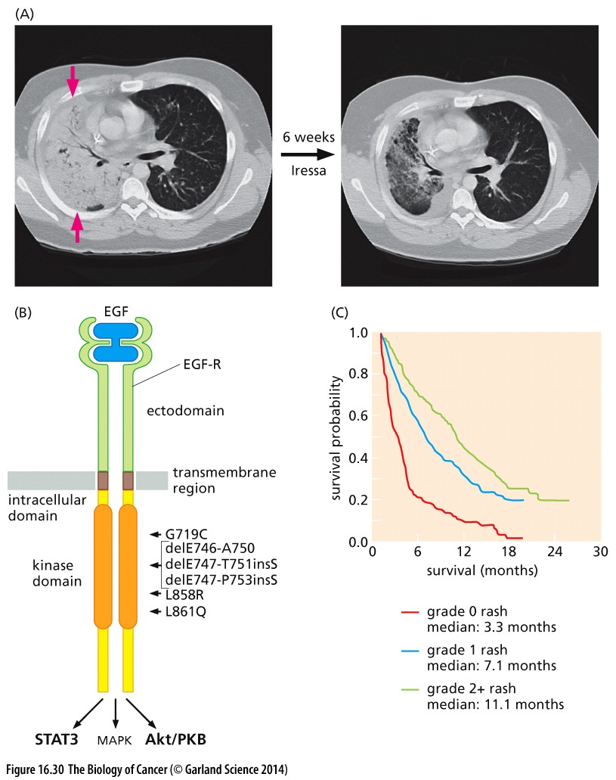
Figure 16.30 Determinants of responsiveness of NSCLCs to Iressa and Tarceva treatment
Almost all of the small group (~10% of the total) of NSCLC patients who had responded well to Iressa treatment (Figure 16.30A) bore tumor cells displaying structurally altered EGF-Rs.

Slide 54
16.14 Proteasome inhibitors yield unexpected therapeutic benefit
Proteasome inhibitor and Multiple myeloma treatment
Multiple myeloma (多发性骨髓瘤) is a cancer of plasma cells, a type of white blood cell normally responsible for producing antibodies
Notes:
骨髓瘤（MM）是一种恶性浆细胞病，其肿瘤细胞起源于骨髓中的浆细胞，而浆细胞是B淋巴细胞发育到最终功能阶段的细胞。因此多发性骨髓瘤可以归到B淋巴细胞淋巴瘤的范围。多发性骨髓瘤较为常见，常伴有多发性溶骨性损害、高钙血症、贫血、肾脏损害等并发症。由于正常免疫球蛋白的生成受抑，因此容易出现各种细菌性感染。发病率估计为2～3/10万，男女比例约在2：1，大多患者年龄在40岁以上。

Slide 55
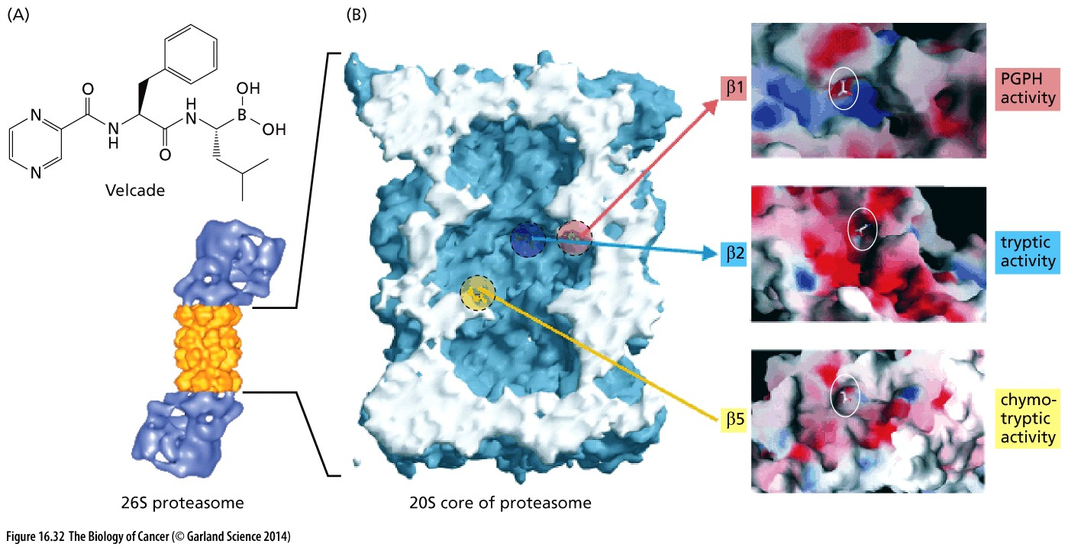
Figure 16.32 Velcade and its effects on proteasomes
Notes:
仅供参考

Slide 56
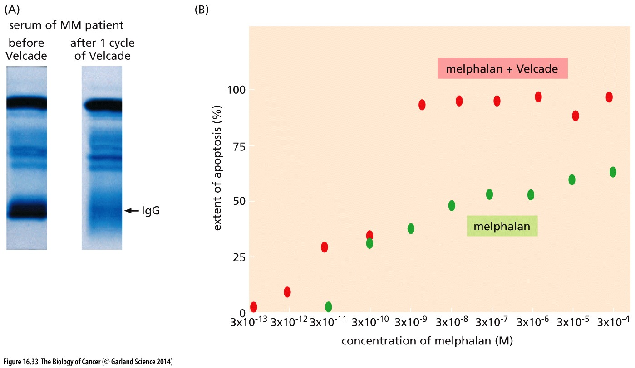
Figure 16.33 Multiple myeloma and the biological effects of Velcade
Melphalan, an alkylating chemotherapeutic drug used routinely to treat MM

Slide 57
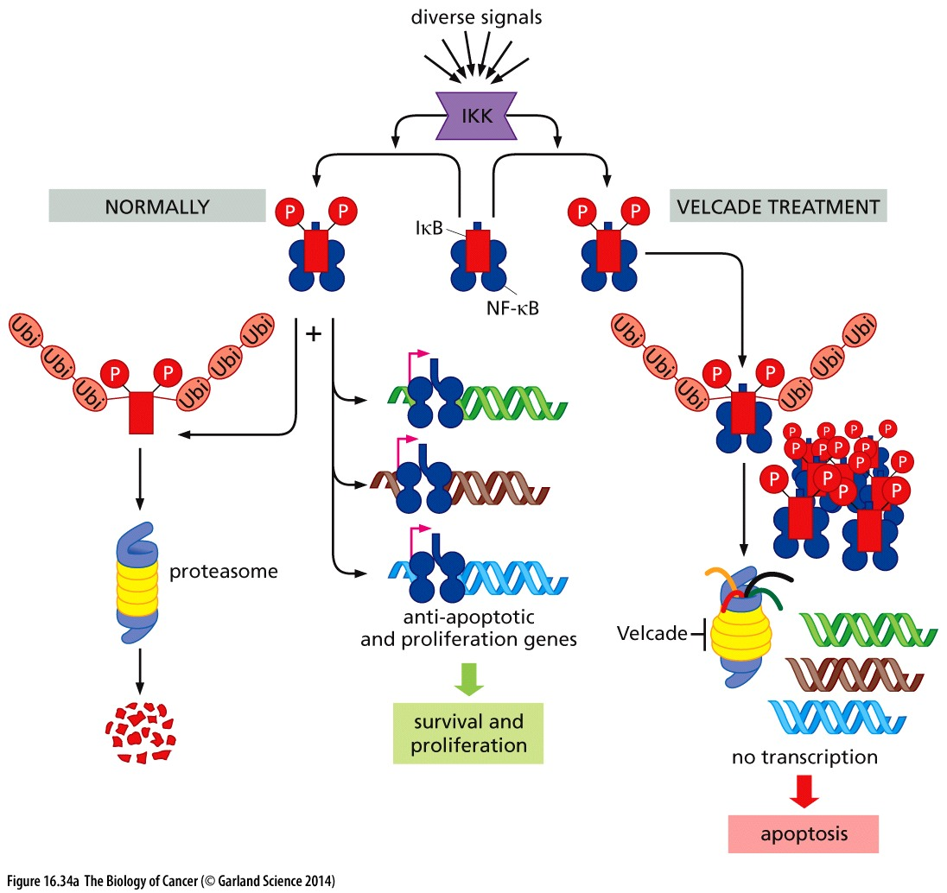
Figure 16.34 Mechanisms of Velcade action
(A) In normal and neoplastic cells, a variety of stress signals activate IκB kinase (IKK). Once activated, IKK phosphorylates IκB. This causes IκB to become ubiquitylated and degraded in proteasomes. NF-κB is then free to move into the nucleus, where it activates the expression of numerous proliferation and antiapoptotic genes. In the presence of Velcade, the ubiquitylated IκB cannot be degraded in the proteasomes. This leads to an accumulation of IκB in the cytoplasm and to the continued sequestration of NF-κB by the IκB molecules that have built up. As a consequence, NF-κB is prevented from moving into the nucleus and activating expression of key anti-apoptotic genes.
Notes:
具体机制仅供参考

Slide 58
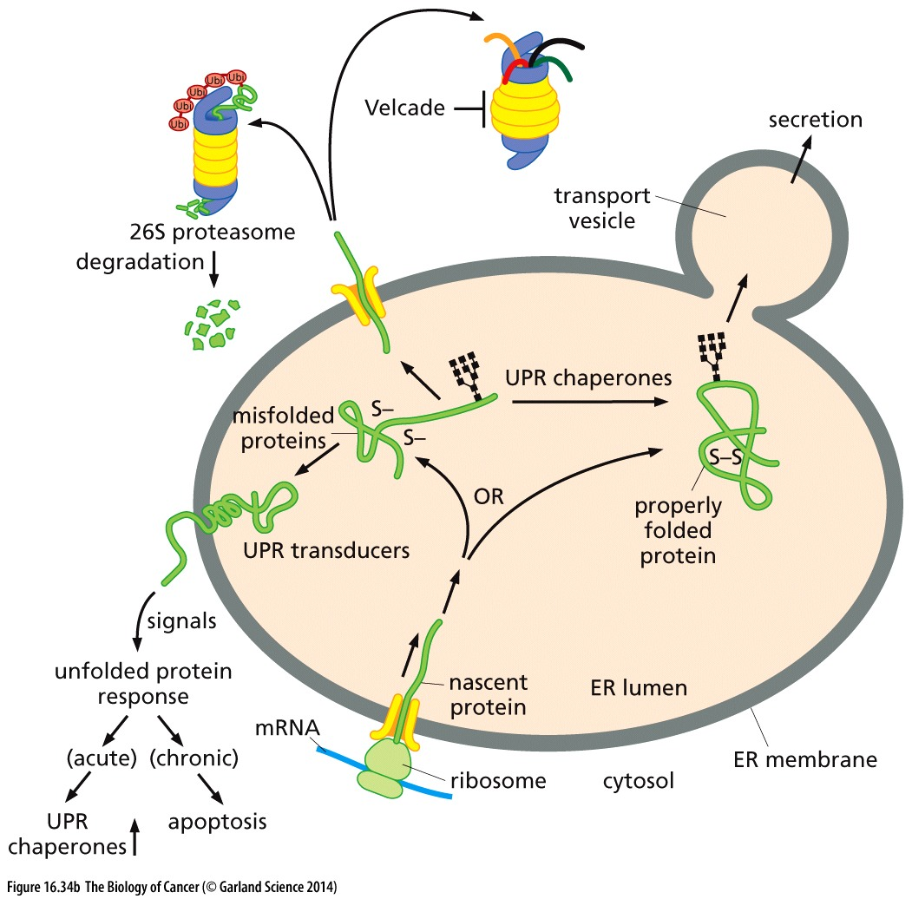
Figure 16.34 Mechanisms of Velcade action
(B) In the absence of proper folding, many of these misfolded proteins are extruded from the ER and broken down, following ubiquitylation, in the proteasomes. However, when proteasome function is blocked by Velcade, misfolded proteins accumulate in the lumen of the ER and trigger the unfolded protein response (UPR). This complex program includes the induction of apoptosis when misfolded proteins accumulate to toxic levels.
Notes:
具体机制仅供参考

Slide 59
16.15 A sheep teratogen(畸胎剂) may be useful as a highly potent anti-cancer drug
Cyclopamine in basal cell carcinoma, medulloblastoma

Slide 60
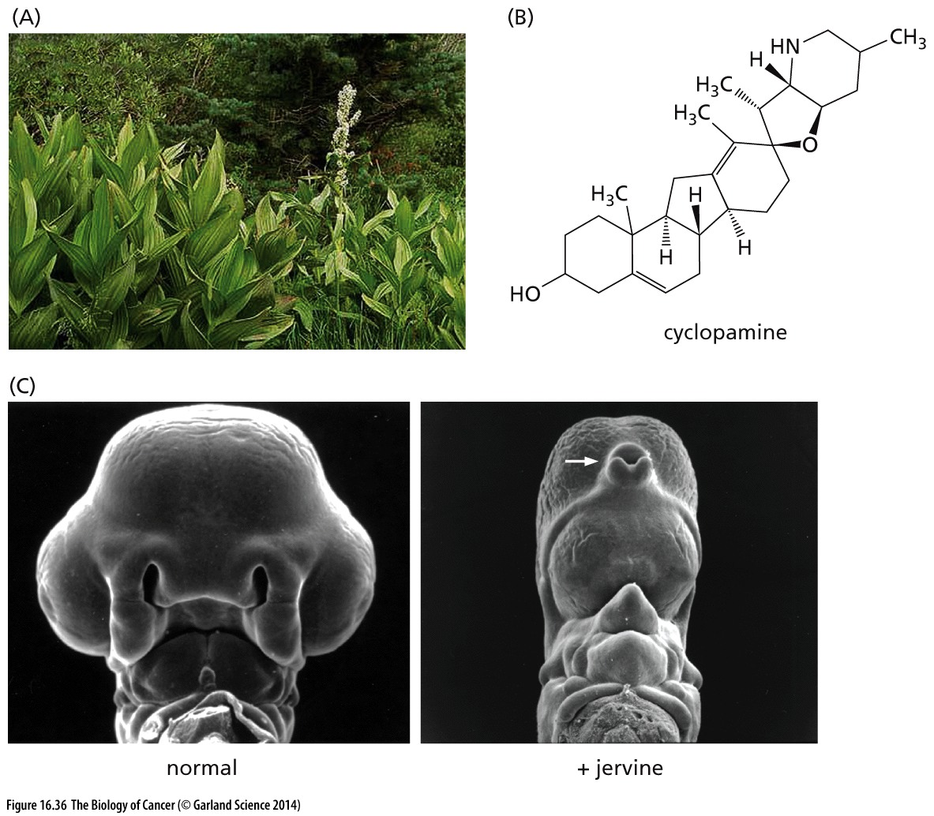
Figure 16.36 False hellebore and its teratogenic product, cyclopamine
Cyclopamine is currently being investigated as a treatment agent in basal cell carcinoma, medulloblastoma, and rhabdomyosarcoma, tumors that result from excessive Hedgehog activity
Notes:
Jervine is similar to cyclopamine

Slide 61
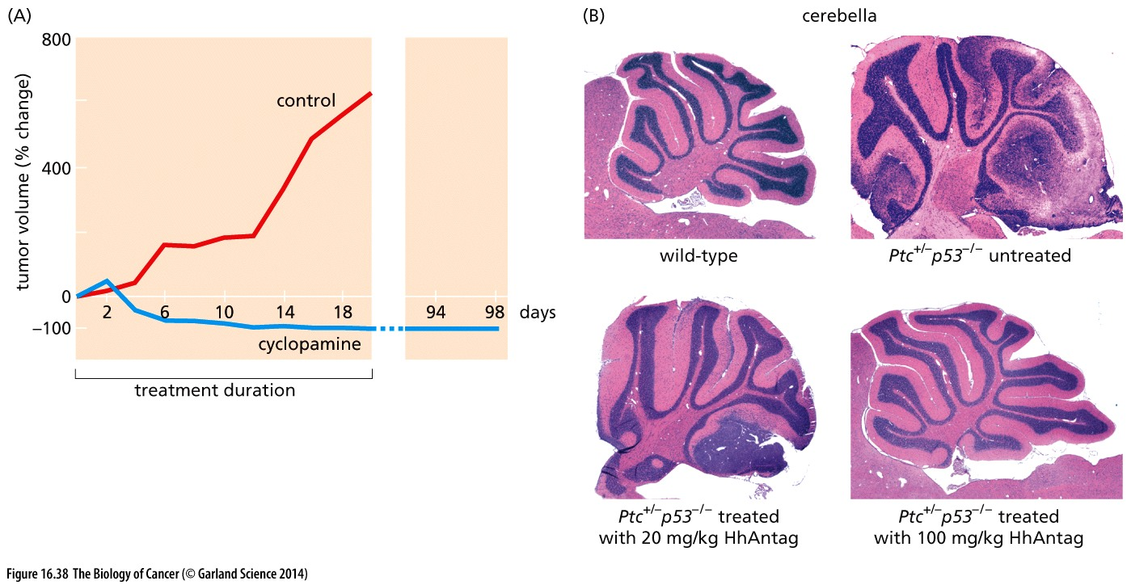
Figure 16.38 Effect of cyclopamine and analogous drugs on tumor growth
Medulloblastomas
Smoothened antagonist, termed HhAntag, similar as cyclopamine
Notes:
Medulloblastoma (髓母细胞瘤) 是颅内恶性程度最高的胶质瘤。其高度恶性表现在三个方面：①生长极其迅速；②手术不易全部切除；③肿瘤细胞有沿脑脊液产生播散性种植的倾向。主要发生于14岁以下的儿童，少数见于20岁以上者。髓母细胞瘤的发病率仅次于小脑星形细胞瘤而居儿童后颅窝肿瘤的第二位。在儿童占神经胶质瘤的10.7%，占颅内肿瘤7.6%。

Slide 62
16.16 mTOR, a master regulator of cell physiology, represents an attractive target for anti-cancer therapy
mTOR: The mammalian target of rapamycin
Rapamycin was was approved by the U.S. Food and Drug Administration (FDA) to prevent immune rejection of transplanted organs, largely kidneys.
Notes:
有很多rapamycin抗肿瘤，以及抗衰老的研究， 但是rapamycin尚未被FDA批准用于治疗肿瘤。

Slide 63
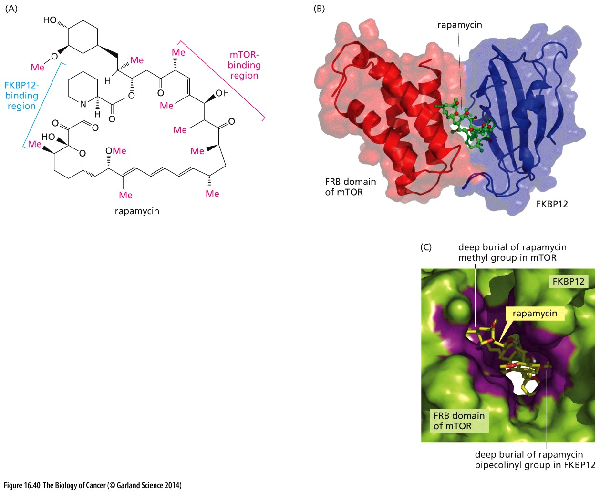
Figure 16.40 Rapamycin, FKBP12, and mTOR

Slide 64
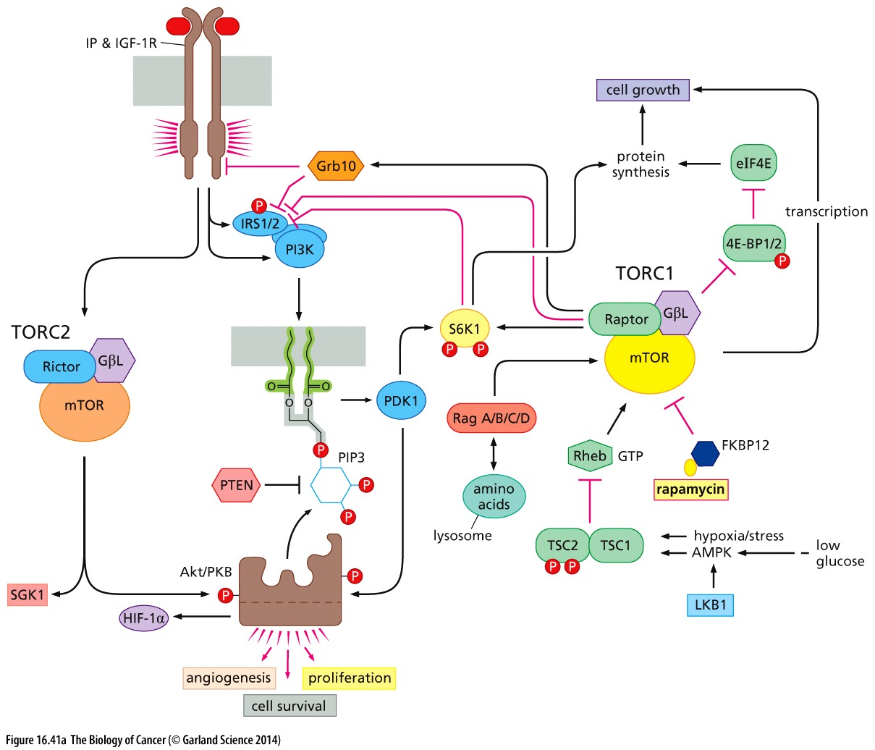

Figure 16.41 The mTOR circuit and tumor responses to mTOR inhibitors

Slide 65
Melanoma(黑色素瘤) treatment
Melanoma is the most dangerous type of skin cancer. Globally, in 2012, it newly occurred in 232,000 people. In 2015 there were 3.1 million with active disease which resulted in 59,800 deaths. Australia and New Zealand have the highest rates of melanoma in the world. There are also high rates in Northern Europe and North America, while it is less common in Asia, Africa, and Latin America. Melanoma is more common in men than women. Melanoma has become more common since the 1960s in areas which are mostly populated with white people.
Late stage melanoma are very easy to become metastatic, probably due to the origin of normal melanocyte.
Prior to the introduction of immunotherapies, median survival of patients with advanced melanoma was about 11 months.

Slide 66

Figure 16.44 Melanoma incidence and mortality
Melanoma incidence in the United States has increased by a factor of 6 over the past half century, raising the question whether this trend has created a comparable increase in the number of cases that truly require aggressive clinical treatment.

Slide 67
16.17 B-Raf discoveries have led to inroads into the melanoma problem
In 2002, sequence analysis revealed the presence of mutant B-Raf alleles (B-raf V600E) in more than half of cutaneous human melanomas.

Slide 68


Figure 16.42 The mutant B-Raf and its treatment
Ninety percent of the mutant B-Raf alleles were found to carry point mutations in
the codon encoding amino acid residue 600, causing a normally present valine to
be replaced by a glutamic acid (Figure 16.42A). B-raf V600E

Slide 69
Vemurafenib and B-raf V600E
In 2011, the drug vemurafenib (previously called PLX4032), which targets specifically the V600E mutant B-Raf protein, received approval for use in metastatic melanomas in Europe, followed soon thereafter by approval in the United States. This represented the first time that these aggressive, late-stage tumors could be treated with significant clinical responses. Thus, over a 6-month trial period, vemurafenib produced a 74% increase in progression-free survival (PFS) and a 20% reduction in overall mortality relative to the standard-of-care at the time, an alkylating agent named dacarbazine. Stated differently, vemurafenib increased overall PFS of these patients by ~4 months. These numbers indicate that vemurafenib offers patients with V600E metastatic melanomas an extension of life span but only rarely a cure. Sooner or later, their tumors develop strategies for evading this drug and thereby acquire the ability to re-erupt, doing so with lethal consequences.
Notes:
目前惟有免疫治疗能给部分melanoma病人一个治愈。

Slide 70

Figure 16.42 The mutant B-Raf and its treatment
in patients whose tumors carried mutations other than the
V600E alteration, vemurafenib actually favored tumor growth
Notes:
具体机制内容仅供参考

Slide 71
One-Third of Patients With Advanced Melanoma Survive at Least 5 Years After Nivolumab Treatment
One-third of patients with advanced melanoma treated with nivolumab (anti PD-1 antibody) were alive 5 years later.
These were heavily pretreated patients with an expected median survival of 11 months.
Five patients stopped treatment and had a recurrence but were retreated with nivolumab and regained response.
These findings imply that nivolumab induces a long-term memory response that contributes to survival.
Hodi FS, Kluger HM, Sznol M, et al: Durable, long-term survival in previously treated patients with advanced melanoma who received nivolumab monotherapy in a phase I trial. 2016 AACR Annual Meeting. Abstract CT001. Presented April 17, 2016.
Notes:
免疫治疗对肿瘤治疗的突破就如同当年的imatinib/Gleevec

Slide 72

Figure 16.47 Genetic diversification and resistance to therapy
The genetic relatedness of the subclones within two ovarian carcinoma patients is indicated here.
Notes:
道高一尺，魔高一丈。进化快的肿瘤克隆对常规靶向治疗更耐受。

Slide 73
Cancer precision therapy
Immunotherapy
Currently very promising field…
More advanced cancer → more tumor antigen → better for immunotherapy
Targeted therapy
Recently just started, may represent future cancer therapy.
Cancer omics (genomics, epigenomics, etc. ) → cancer driver → target for each cancer driver
Challenge for cancer precision therapy: Intra-tumor heterogeneity
Notes:
癌症治疗的未来, Immunotherapy target cancers with high immunogenicity

Slide 74
课后作业
1，简述常见化疗药物的类型，以及代表药物
2，简述烷化剂治疗癌症的机制

